Slide 1
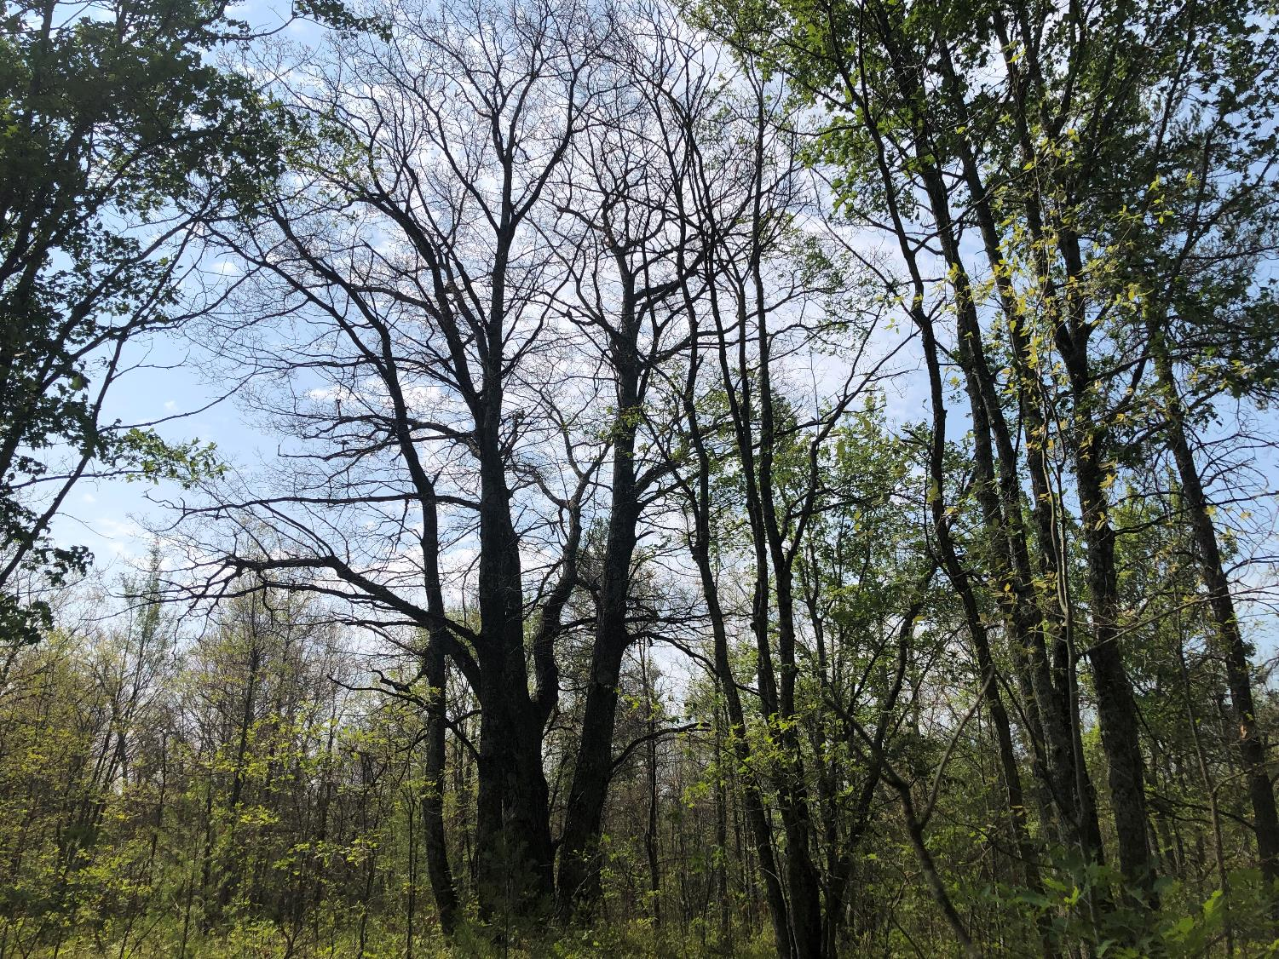
Michigan
Forest Health Update
Simeon Wright/MI DNR Forest Health Specialist

Slide 2
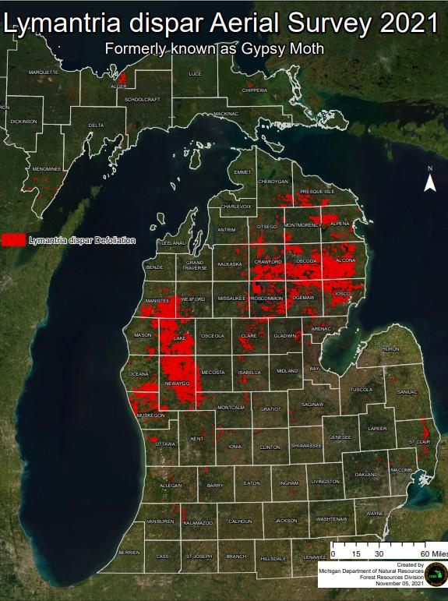
Spongy Moth
1.2 million acres > 50% defoliation
24 million acres flown
Notes:
Flight lines 6 miles apart, ~3500 feet or higher for these big events.

Slide 3
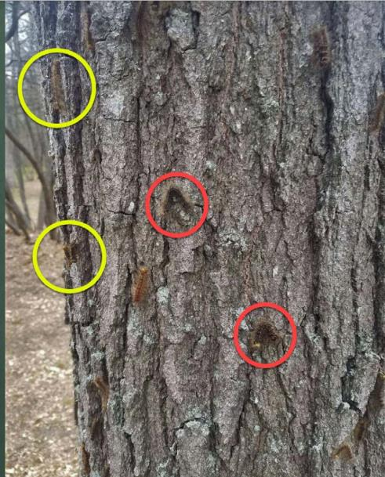
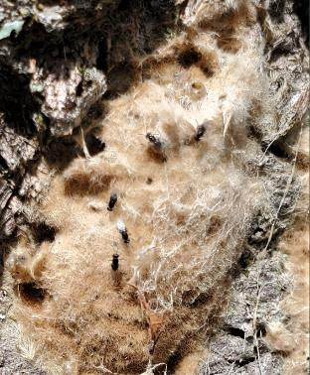
History…
2010: >500,000 acres
2019: 250,000 acres
2020: 950,000 acres
2021: >1 million acres
Anticipate collapse in many areas in 2022
Notes:
The last significant outbreak occurred in 2009-2010. Dry springs and late frosts contributed to rapid increase in defoliation especially in 2020, 21. Have seen collapse in affected areas, increase in other areas, localized outbreaks in 2022. Parasitoids

Slide 4
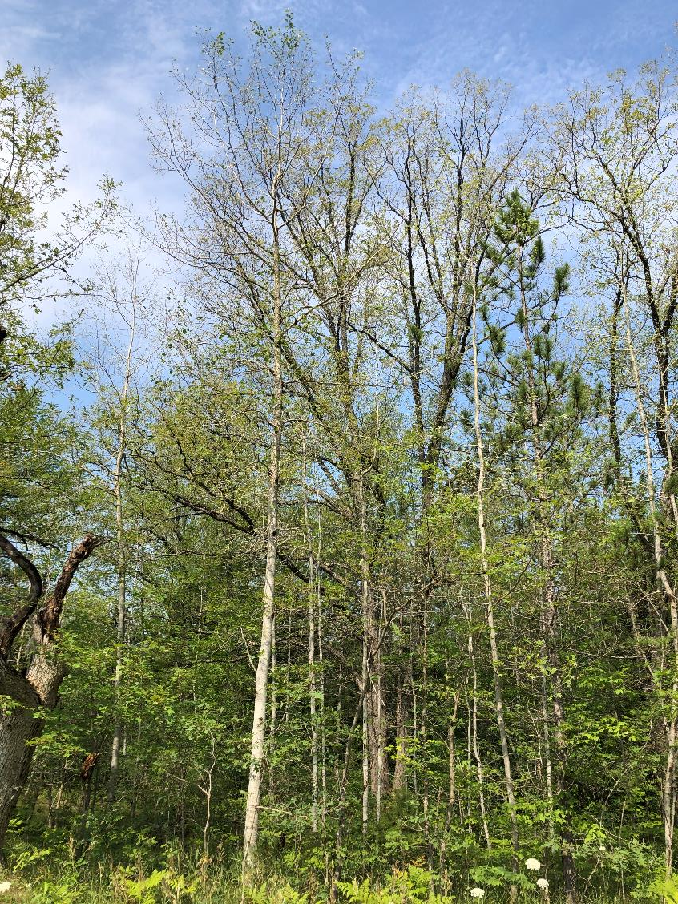
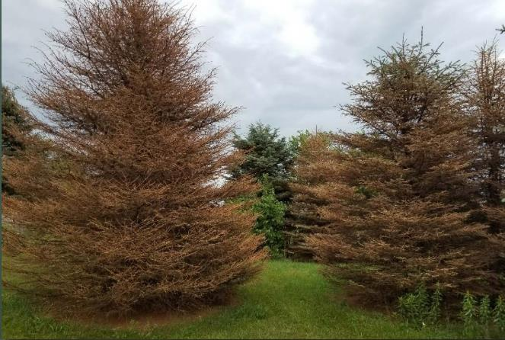
Impacts
Abundant rainfall
Healthy trees will recover

Slide 5
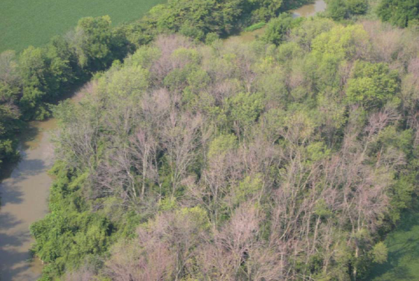
Emerald Ash Borer:
How long in MI?
EAB first detected in 2002
Infesting ash trees 10-12 years prior

Slide 6
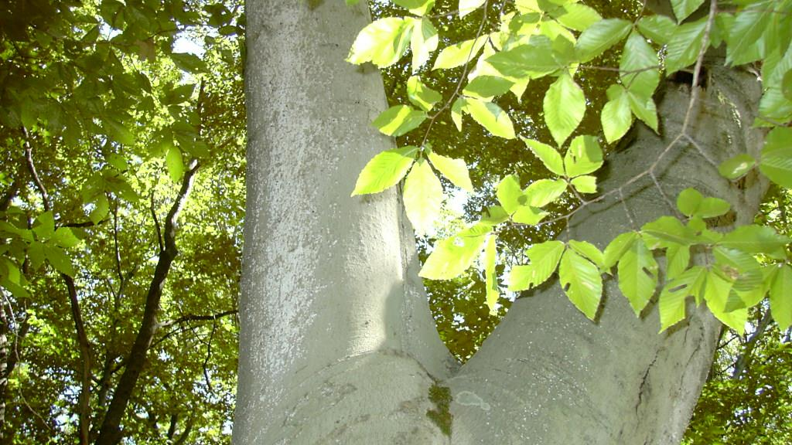
Beech Bark Disease:
How long in MI?
BBD first detected in 2000
Likely introduced to UP around 1985-1990

Slide 7
?

Slide 8
Balsam Woolly Adelgid
Notes:
Our state department of agriculture is the lead on this pest

Slide 9
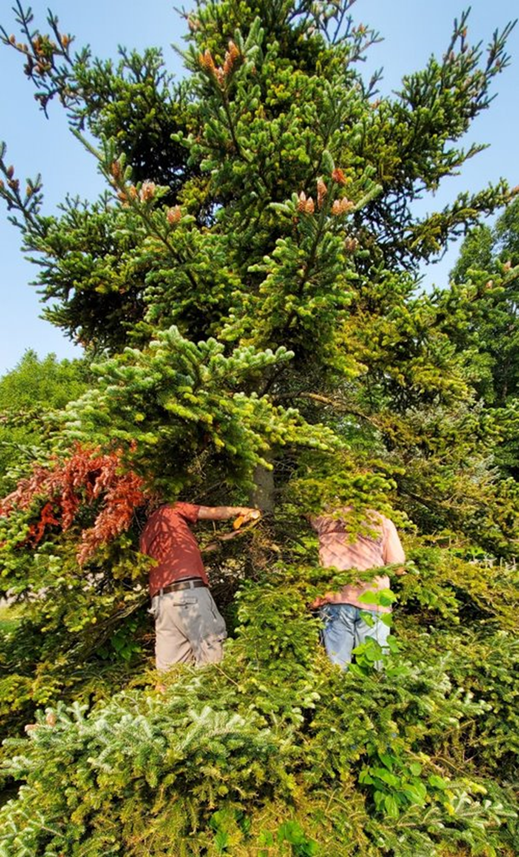
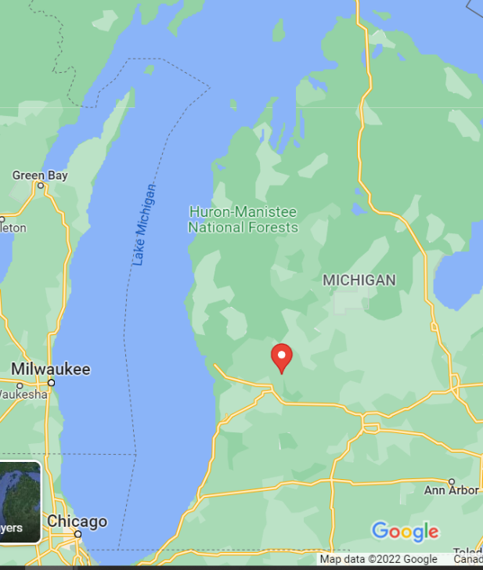
Initial detection
Arborist report
Notes:
Report to MISN by alert arborist. Trees were transplanted over 20 years ago. Nathan Havill genotyped the BWA samples and matches those widespread in the Appalachians and western North America. In other words, the results are consistent with our hypothesis that infested trees were brought up from a nursery in the Appalachians region.

Slide 10
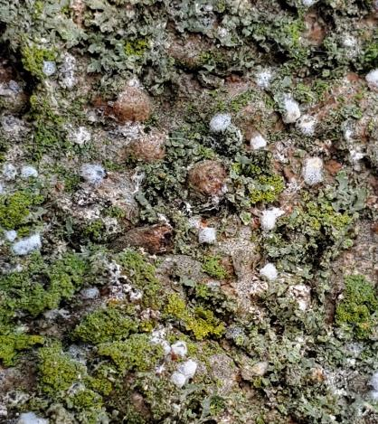
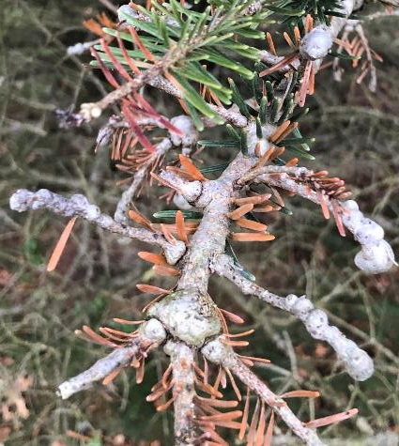
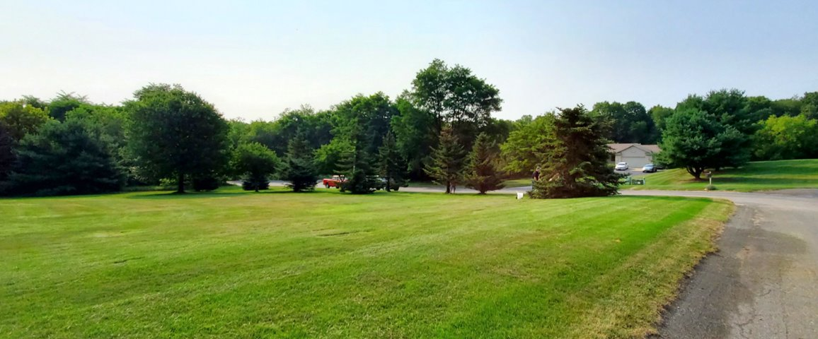
Infested site
8 Fraser Firs
20-25 years old
Notes:
Note that the 8 firs are along the road. Several other firs had lined the road from the photographer to the corner that had been removed over the last few years. They were most likely infested before they were taken down – potential for additional spread. Concern about other similar situations. Nursery stock believed to bring HWA into the state prior to quarantines as well

Slide 11
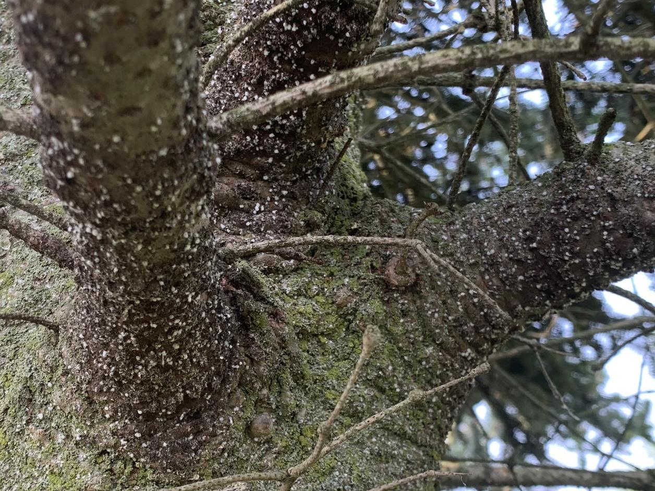
What’s being done?
`
`
Eradication
Surveys
Quarantine

Slide 12
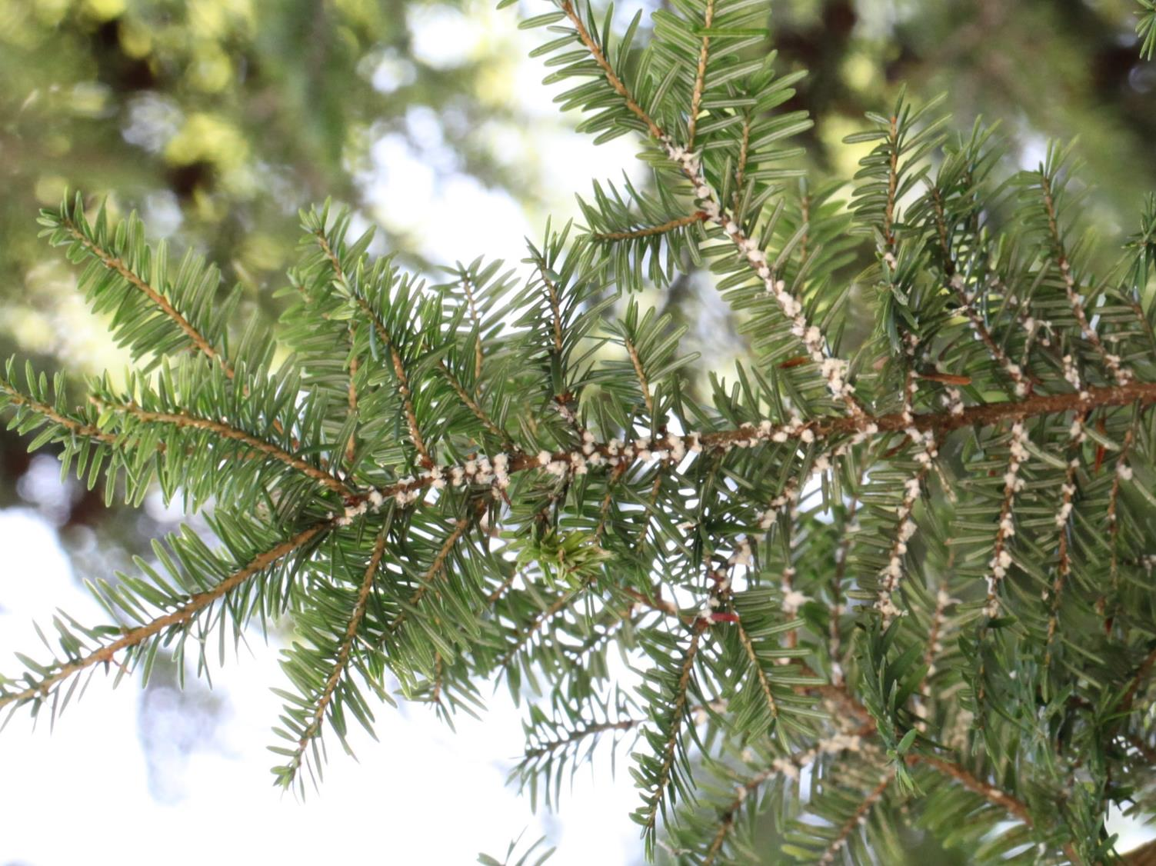
Hemlock Woolly Adelgid

Slide 13
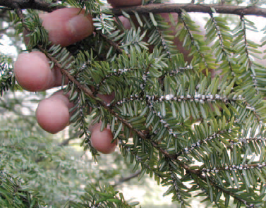
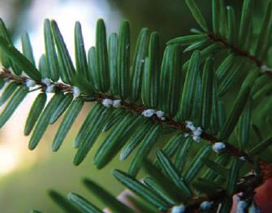
HWA: What to look for
White cottony masses on twig at needle base

Slide 14
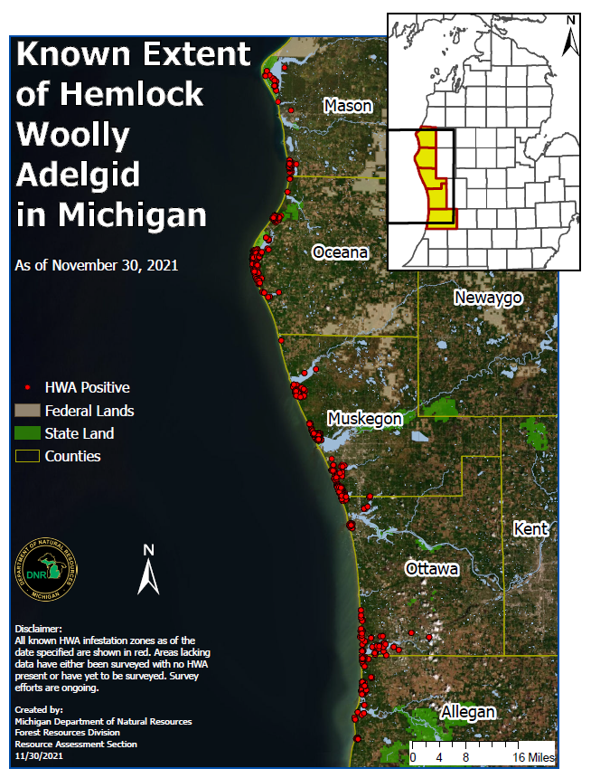
Five Counties – 110 miles
20,000 acres infested
Top-Down Approach
Notes:
First detections 15+ years ago are thought to be from infested nursery stock and to be successfully eradicated. Much of current distribution recognized over the past 5 years or so- single tree infestation further north in Benzie county confined to a single tree and eradicated. Most of Michigan’s 176 million hemlock are north of existing infestation

Slide 15
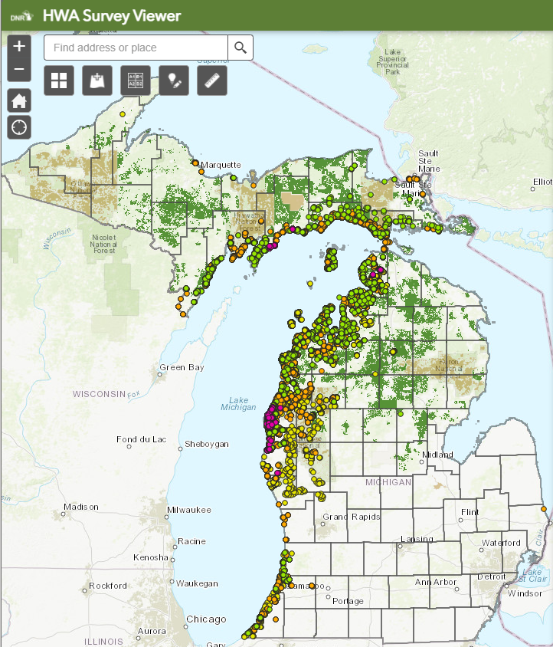
Survey Efforts Since 2018
Multiple partners
14,419 acres surveyed
38 Counties

Slide 16
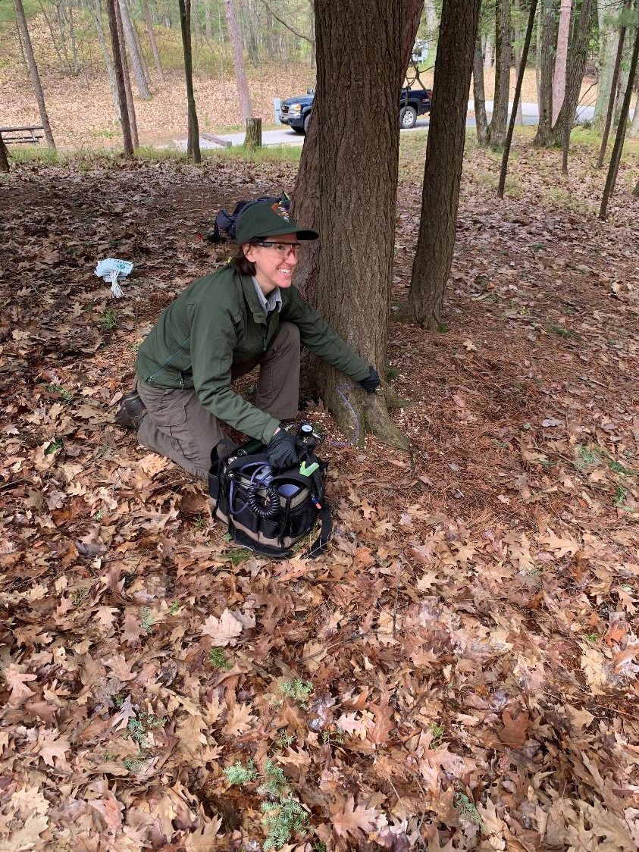
Treatments
Focused on northern extent
7,500 acres and 118,500 trees since 2017
~40% known infested acres treated

Slide 17
Oak wilt
Notes:
6 miles NE of Iron Mountain

Slide 18
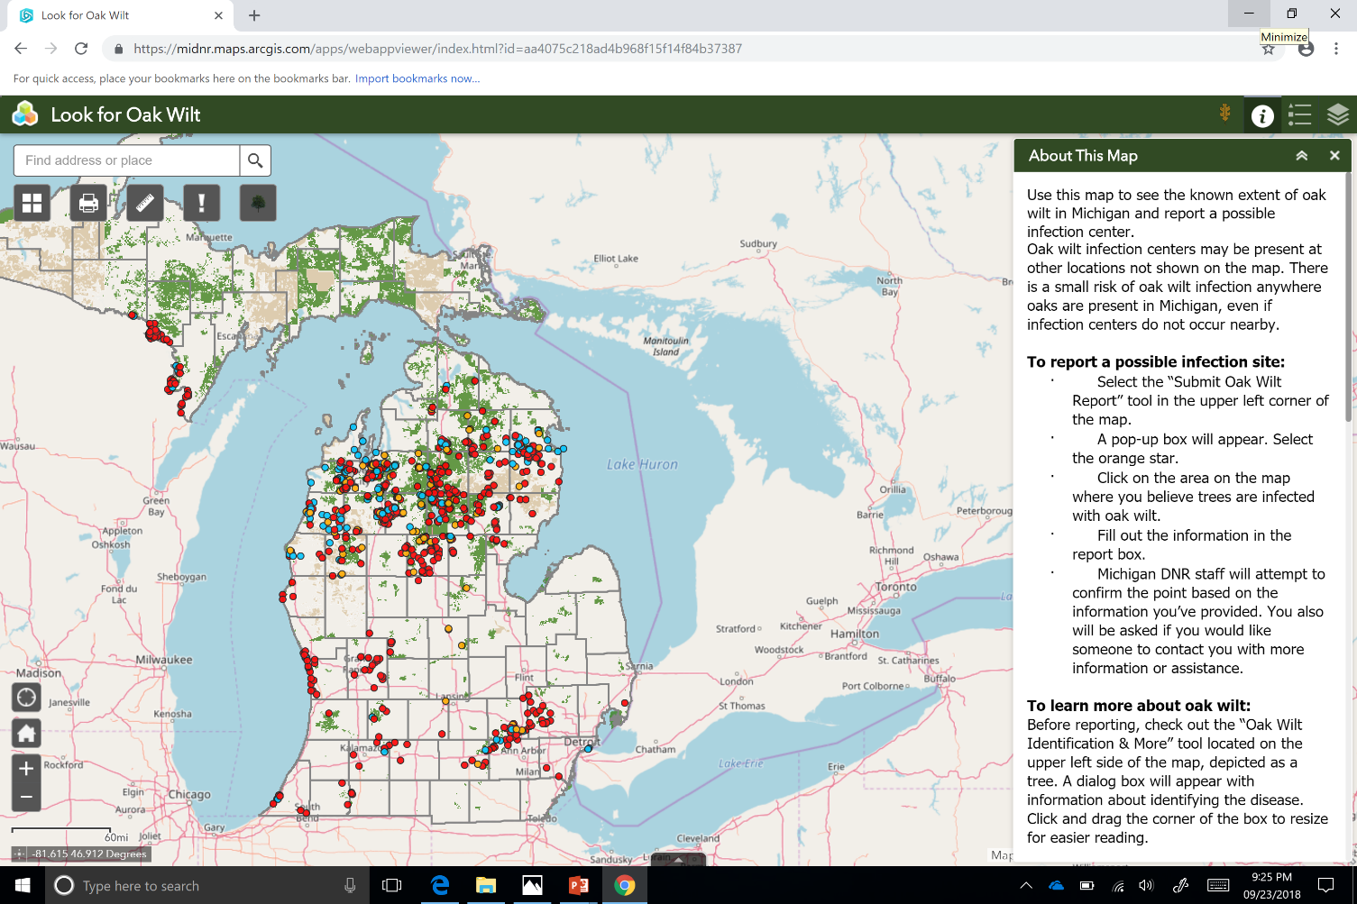

Slide 19
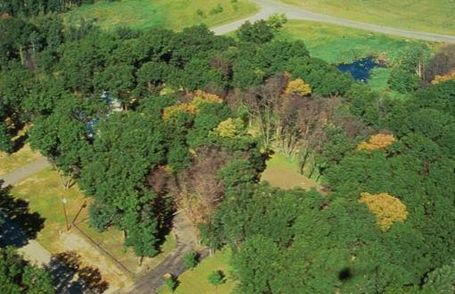
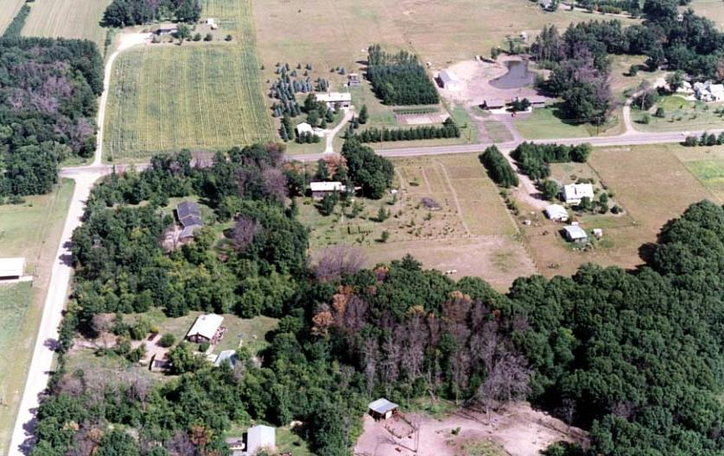
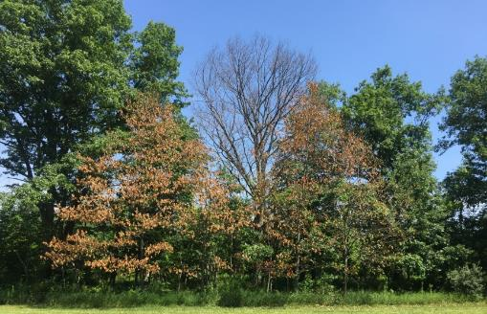
Oak Wilt Symptoms: pockets of dead trees

Slide 20
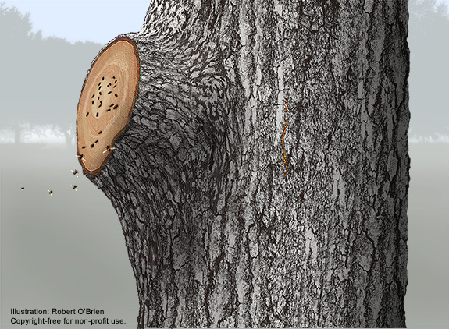
Oak wilt: Overland spread
Wounding
April 15-July 15
Notes:
In northern MI, MSU found more than 95% of contaminated beetles captured during the growing season were in Mid-May to mid-June. 6 species of Nitidulids were found carrying spores, DD not worked out for all of them.At a site with extremely high disease pressure, 3 contaminated beeltes were detected in August. They were unsuccessful at even artificially infecting trees before mid March or after September. 12 field sites were evaluated 2x per month from March to November for 2 years. Mats were never found before late April.

Slide 21
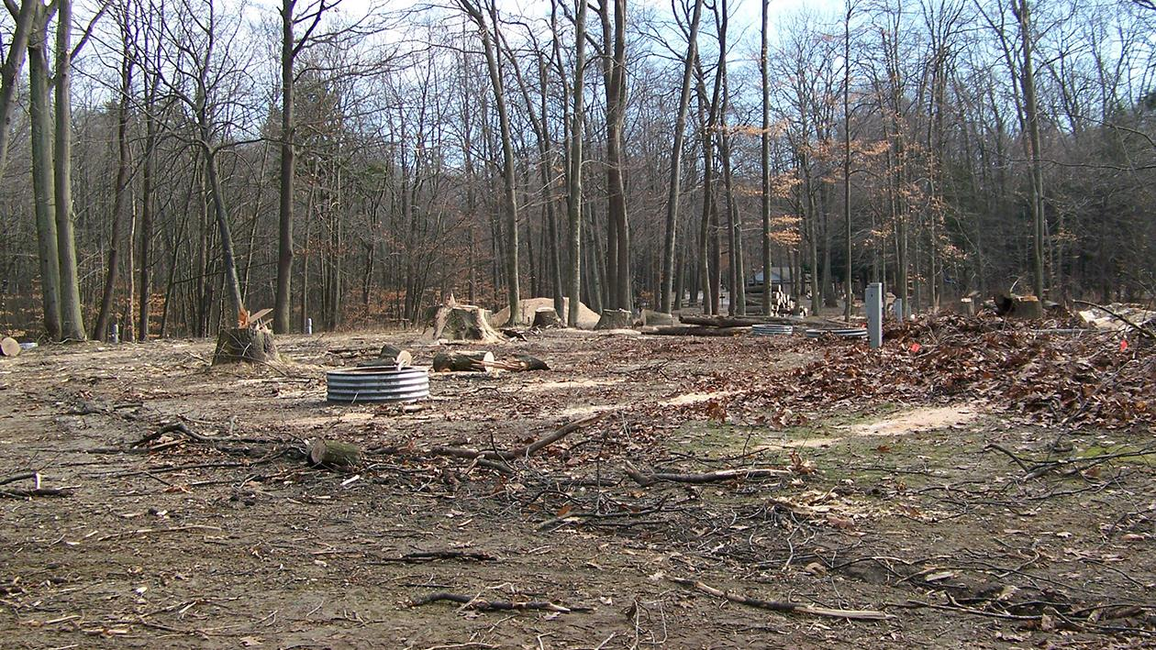

Slide 22
Heterobasidion root disease
(HRD)
Expanding pockets of mortality

Slide 23
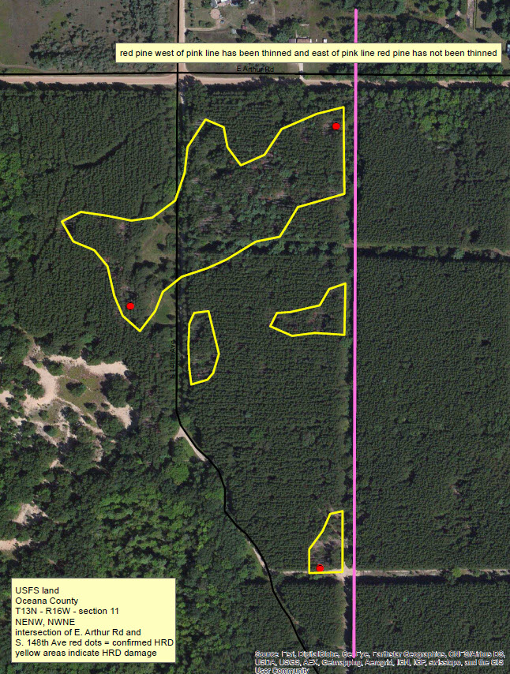
west of pink line has been thinned
east of pink line has not been thinned

Slide 24
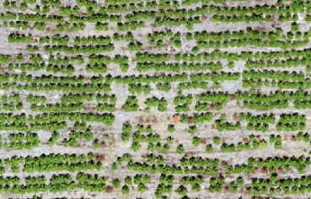
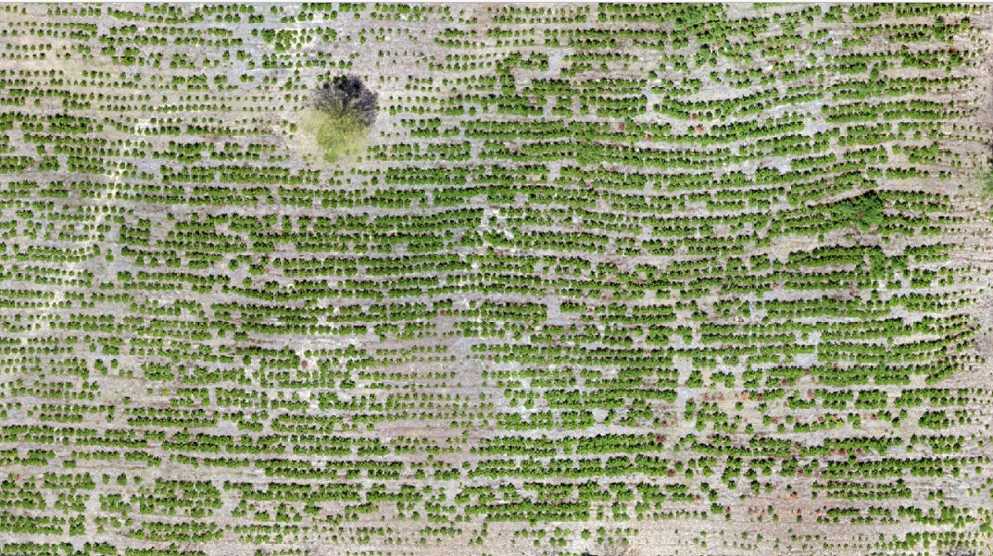
Disease of the site…
Notes:
Young HRD stand in GT County 6 years after planting. The stand is currently aged at 9 years, the imagery was taken in May of 2019, and the HRD was discovered in 2018. Not all mortality is from HRD

Slide 25
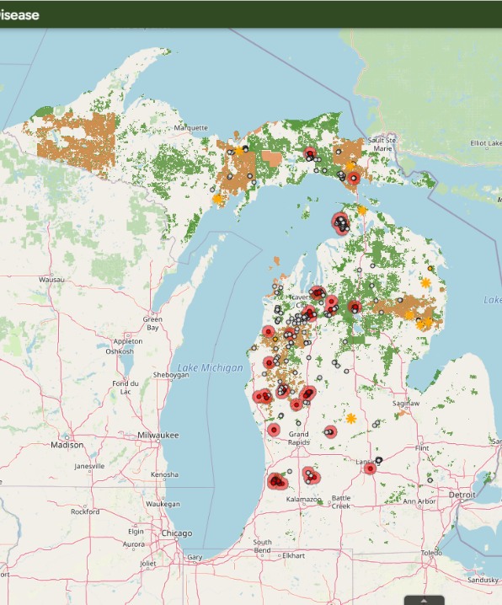
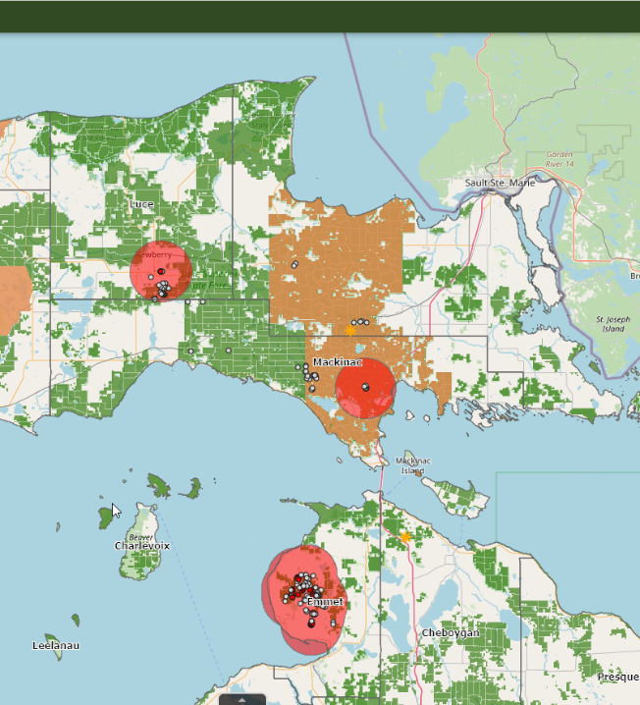
michigan.gov/foresthealth
Notes:
Majority of spores within 1000 feet, less than ¼ mile from the source. Disease typically moves 3.5-6.5 feet per year

Slide 26
I see dead trees…

Slide 27
Report Suspect Invasive Forest Pest Infestations
Phone: (800)292-3939
(MDARD Customer Service Center)
Online: www.misin.msu.edu
Email: MDA-info@Michigan.gov
DNR-FRD-Forest-Health@Michigan.gov

Slide 28
Exterior firewood quarantine
Notes:
Firewood from out of state must be heat treated, 140 degrees F. Lumber, wood chips exempt. Loogs and wood direct to mills for immediate processing is exempt. Slab wood produced from out of state sources requires compliance agreement.

Slide 29
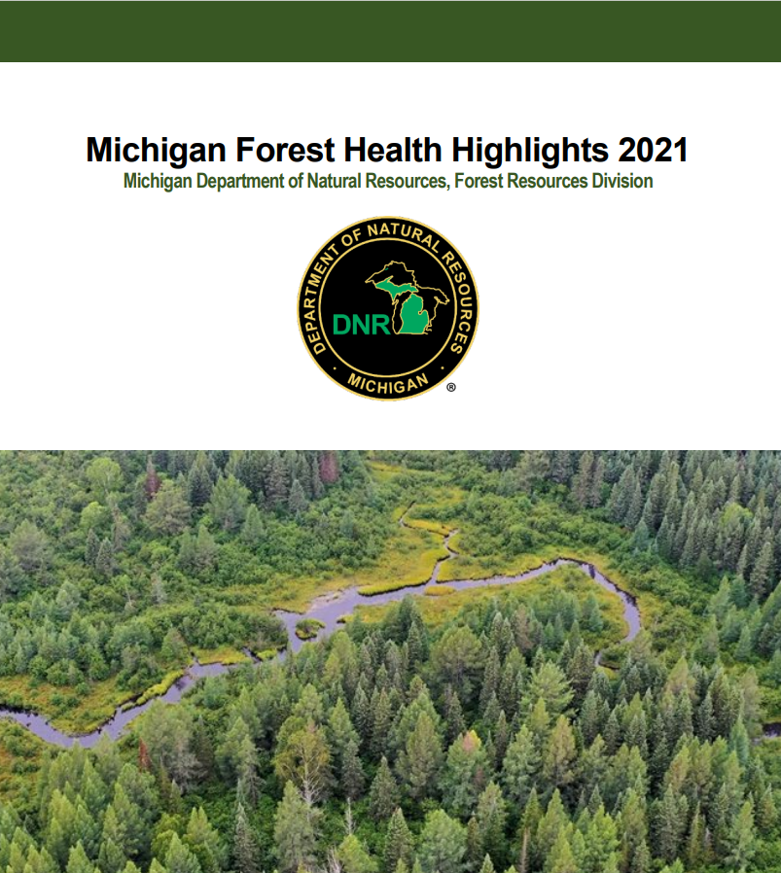
www.michigan.gov/foresthealth

