Slide 1
Rare Species and Biodiversity Conservation in Michigan
Brenda Haskill
MDNR Forest Resources Divison
Notes:
A review of T/E Protections on State Forest in Michigan.

Slide 2
Presentation Overview
Basis for T/E Protections
Federal and State Laws
Forest Certification
Seasonal Restrictions

Slide 3
Laws and Regulations
Federal Endangered Species Act
State T&E legislation, Part 365
Regulations on the Take of Reptiles and Amphibians
Bald and Golden Eagle Protection Act
Ginseng Act
Christmas Tree Act
Notes:
A number of state and federal laws impact RTE species. I will review each of these in more detail.

Slide 4
Endangered Species Act of 1973
Fish and Wildlife Service has authority
Section 9 of the ESA prohibits activities that might “take” a listed species
Federally listed plants are protected only when there is a federal nexus
Federal nexus: land, funding, agency
Federal ESA vs. State law
Notes:
Federal ESA of 1973
There are exemptions:
Designated as a Non-essential Experimental population
Each species has special rules
Whooping crane
**Whooping Crane - A nonessential experimental population of the whooping crane was designated in a 20-state area of the eastern United States in 2001. The first release of birds occurred in Wisconsin in 2001, and the counties listed are those where the species has been observed. For purposes of section 7 consultation, this species is considered as a proposed species, except where it occurs within the National Wildlife Refuge System or the National Park System, where it is treated as a threatened species.
Take laws can be specific to each non-essential experimental population - 10(J)

Slide 5
What is “Take”?
“Take” of fish and wildlife: to harass, harm, pursue, hunt, shoot, wound, kill, trap, capture, collect, or attempt to engage in any such conduct
“Harm” includes habitat destruction that kills or injures listed species
“Take” of plants: to collect, pick, cut, dig up, or destroy in any manner
Notes:
Section 9 ESA take prohibitions
Includes habitat destruction, state ESA does not.

Slide 6
When is “Take” Allowed?
Section 10: incidental take permits
Enhancement of Survival
Research and Recovery
Safe Harbor Agreement
Candidate Conservation Agreements
Incidental take permits
Habitat Conservation Plans
Section 7: Consultation
a process for federal agencies to receive “take” exemption
Notes:
Section 10 of ESA. Bat HCP authority under this section.
HCP—Karner blue butterfly has one, Mitchell’s Satyr and Poweshiek Skipperling are in the final steps, bats recently approved. Post-listing
Safe Harbor-private landowners-protects private landowners who want to do habitat management or make positive changes for conservation should the species decrease on their property to pre-safe harbor levels

Slide 7
When is “Take” Allowed?
Section 6: Cooperative Agreement
DNR has program to benefit T&E species
FWS will provide financial assistance
Funding contingent on continued T&E program
Law enforcement activities are cooperative
Work together to develop programs and projects to benefit T&E species
Share data on T&E species locations

Slide 8
When is “Take” Allowed? Section 6 (cont.)
DNR staff who are qualified may “take” federally listed fish and wildlife for conservation purposes that are consistent with the agreement such that is does not result in:
The death or permanent disabling
Removal from the State
Introduction beyond historic range
Holding in captivity beyond 45 days
Notes:
Purpose of the Cooperative Agreement: to provide a means whereby the ecosystems upon which endangered and threatened fish, wildlife and plants depend may be conserved, to provide a program for the conservation of such species, and to take such steps as may be appropriate to achieve the purposes of various treaties and conventions related to the conservation of fish, wildlife and plants.
Overall conservation benefit. Only applies to endangered spp. For threatened, have more flexibility as long as we agree with the FWS that it is a conservation benefit

Slide 9
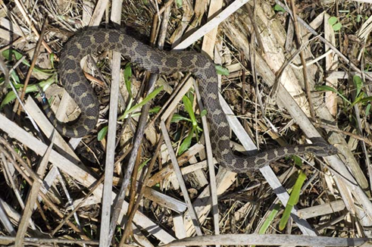
Eastern Massasauga Rattlesnake CCAA
Enhancement of Survival Permit
Managed and unmanaged lands
Conservation measures
Prescribed fire
Mowing and hydro-axing
Cultivation
Water level manipulation
Forest management
Chemical control
Notes:
Approved August 2016
Without blanket permit, would need individual permits
All of the Lower Pennisula plus Bois Blanc Island
Managed Lands are most important, Unmanaged Lands generally not good habitat for EMR or have an incompatible purpose
CCAA demonstrates a net conservation benefit for EMR.

Slide 10
Bat Habitat Conservation Plan
Indiana Bat, Northern Long-eared Bat, Little Brown Bat, and Tricolored Bat
Incidental take permit
Provide for covered activities including forestry and prescribed burns
Non-Federal Landowner Enrollment
MI, MN, WI DNRs
Notes:
Indiana Bat – federal endangered
Northern Long-eared Bat – became federal endangered March 31, 2023
Tricolored Bat – listing decision is expected by September 2023
Little Brown Bat – under Species Status Review
Protects important habitat features – hibernacula and know maternity roost trees
Demonstrates net conservation benefit for covered bat species.

Slide 11
State Endangered Species Law
Part 365 of NREPA, Act 451 of 1994
Definitions
Duties
Investigations
Programs, cooperative agreements
Prohibitions and exemptions
Enforcement
Violations
Notes:
Natural resources and environmental protection act (NERPA)

Slide 12
Michigan Endangered Species Law Part 365 of PA 451 of 1994
Prohibits harm to species listed as threatened or endangered on public or private land
Includes animals and plants
Permits may be issued to alleviate damage to property or to protect human health or for scientific purposes

Slide 13
Examples of “Take”
State listed species
Cutting down a tree with an active nest of a listed bird species
Heavy equipment crushing a listed turtle
Collecting seeds of listed plant species
Applying herbicide to listed plant
Notes:
Direct harm to organism for state. Federal is this and damage to habitat, etc.
There is no incidental take allowed under state law. ((We could develop a “program,” but we haven’t.)

Slide 14
Species of Special Concern
Goal: track and manage to avoid future endangerment
When and where possible treat with similar management consideration as listed species
However, no protection under Part 365
Notes:
Declining or relict populations that, if continue to decline, may be listed as threatened or endangered
NOT legally protected
State land policy—treat as listed species
intent is to keep off the ESA

Slide 15
Christmas Greens and Wildflower Protection Law Public Act 182 (1962)
Protects attractive plants from collectors and commercial exploitation, to prevent these plants from becoming rare
Prohibits collection of plants on list on someone's land without their permission
If these plants occur on your land, you may do as you wish with them, except if they are also threatened or endangered
Species include trilliums, holly, bittersweet, etc.
Notes:
Protects attractive plants from overzealous collectors and commercial exploitation, to prevent these plants from becoming rare.
Prohibits collection of plants on list on someone's land without their permission.
If these plants occur on your land, you may do as you wish with them, except if they are also on the endangered species list.
Species includes trilliums, holly, bittersweet, etc.
(a) Christmas trees.
(b) Evergreen boughs.
(c) Any other trees, shrubs, or vines.
(d) Trailing arbutus.......... Epigaea.
(e) Bird's foot violet........ Viola pedata.
(f) Climbing bittersweet...... Celastrus scandens.
(g) Club mosses............... Lycopodiaceae.
(h) Flowering dogwood......... Cornus florida.
(i) All Michigan holly........ Ilex sp. and nemopanthus sp.
(j) North American lotus...... Nelumbo sp.
(k) Pipsissewa................ Chimaphila umbellata.
(l) All native orchids........ Orchidaceae.
(m) Trilliums................. Trillium sp.
(n) Gentians.................. Eustoma sp.

Slide 16
Michigan Ginseng Act
Passed in 1994 to regulate the harvest, sale, and distribution of American Ginseng in Michigan
This act covers both cultivated and wild ginseng
Unlawful to take ginseng from the wild without a permit from the DNR
Notes:
Ginseng is extremally rare in Michigan. Act protects wild and cultivated ginsing.

Slide 17
Director’s Order on Take of Reptiles and Amphibians
Unlawful to kill, take, trap, possess, buy, sell, offer to buy or sell, barter, or attempt to take, trap, possess or barter any reptile or amphibian from the wild, or the eggs of any reptile or amphibian from the wild, except as provided within this order
Includes T&E and SC species
Fishing License required for take of allowed species
Reptiles and amphibians may not be bought, sold or offered for sale.
Notes:
Responsibility for reptiles falls with MDNR fisheries division

Slide 18
Bald & Golden Eagle Protection Act
Federal law enacted in 1940
Prohibits anyone to "take, possess, sell, purchase, barter, offer to sell, purchase or barter, transport, export or import, at any time or any manner, any bald eagle ... [or any golden eagle], alive or dead, or any part, nest, or egg thereof."
Also covers impacts from human-induced alterations around nest sites when eagles are not present that interferes with or interrupts normal breeding, feeding, or sheltering habits, and causes injury, death or nest abandonment

Slide 19
Michigan’s Rare Species
 | Endangered | Threatened | Extirpated
Insects (??,000) | 15 | 15 | 4
Plants (1,800) | 88 | 186 | 60
Birds (414) | 7 | 18 | 1
Mollusks (257) | 23 | 12 | 2
Fishes (152) | 12 | 10 | 9
Mammals (66) | 4 | 5 | 4
Reptiles (29) | 2 | 6 | --
Amphibians (23) | 2 | 1 | --
Totals | 138 | 258 | 62
MDNR Website, Revised 2023
Notes:
Total number of insects in MI is unknown. State T&E list just updated for first time since 2009.

Slide 20
Why do species become endangered?
The main reason plants or animals become endangered or threatened is because of the loss or destruction of the habitat (food, cover, water, or space) that these species depend upon for survival
Every species requires a certain habitat to live; Michigan has many different types of habitats from the Great Lakes to prairies to forests to wetlands.
In Michigan, the dramatic loss of wetlands (to drainage and fill) over the last 50 years or so, has raised real concerns about associated loss of plant and animal life.
However, many T & E species are listed because of the rare or unique habitats that they inhabit (require for survival)

Slide 21
Rare Species Resources
Michigan Natural Features Inventory (MNFI) http://mnfi.anr.msu.edu/
U.S. Fish & Wildlife Service - Midwest Endangered Species http://www.fws.gov/midwest/endangered/
State Wildlife Action Plan http://www.michigan.gov/dnrwildlifeactionplan/
International Union for Conservation of Nature – Red List http://www.iucnredlist.org/
Michigan DNR – Endangered and Nongame Wildlife http://www.michigan.gov/nongamewildlife

Slide 22
QUESTIONS SO FAR?
Notes:
Pause for questions

Slide 23
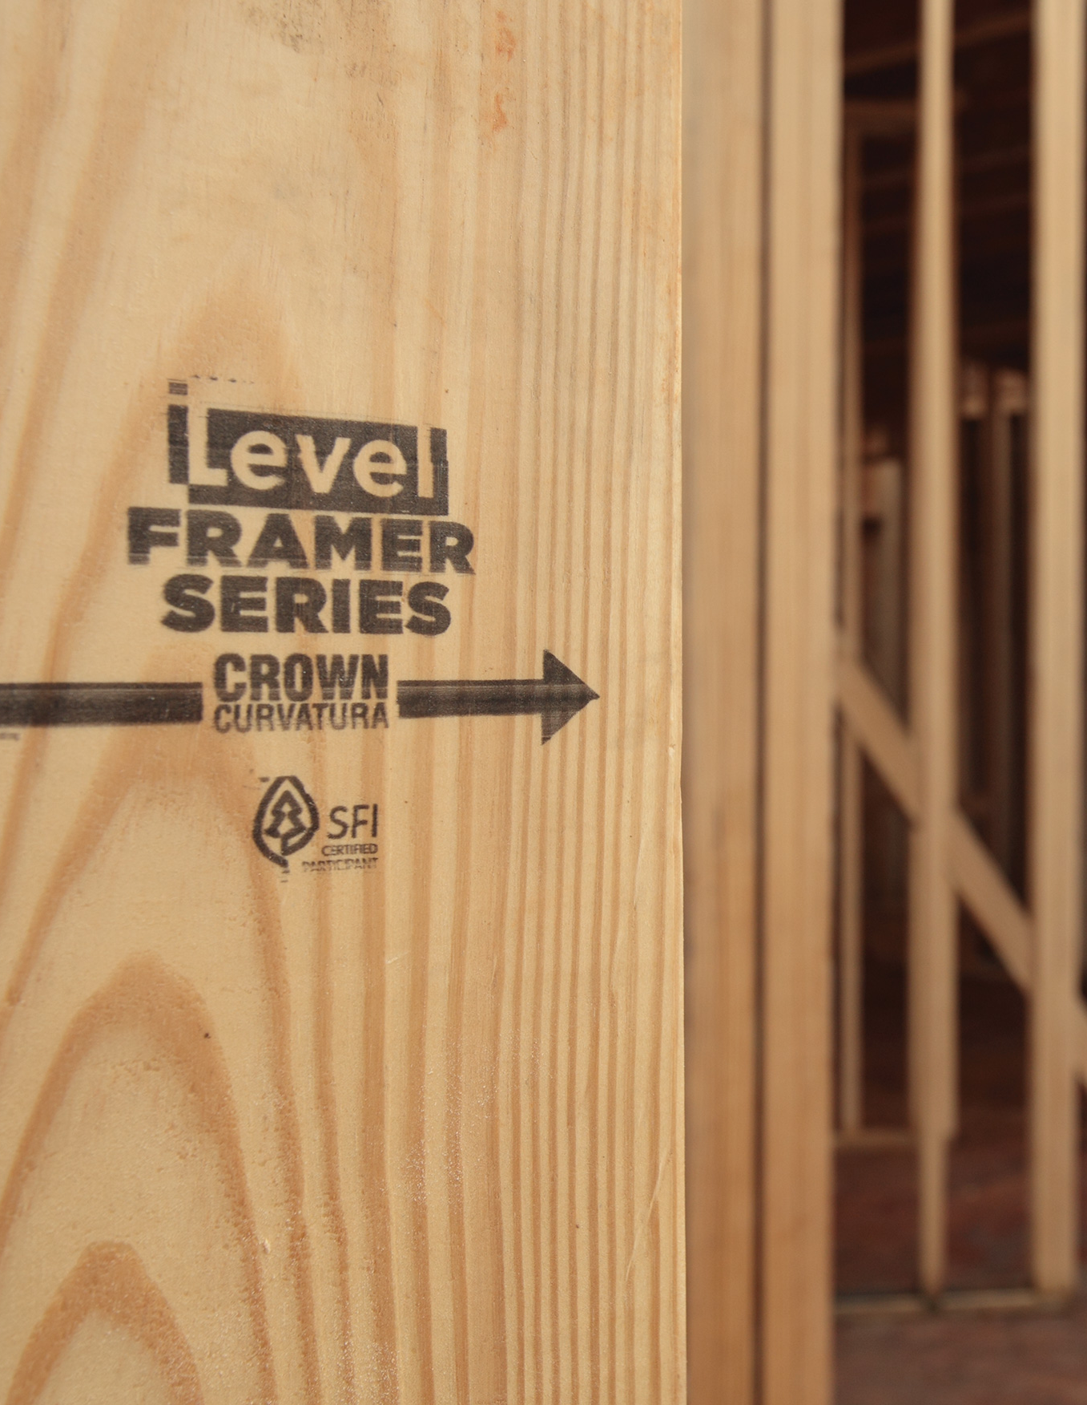
Forest Certification: Improving Management & Consumer Confidence
Forest stewardship Council™ (FSC) & Sustainable Forestry Initiative™ (SFI)
Notes:
An important factor influencing public land management and conservation is the rise in public awareness and a desire by consumers to better understand the impacts of their purchasing choses on the environment. Responsibly-sourced certification and product labeling is a direct outcome of this consumer demand. Examples include organic, shade grown coffee, fair trade, and forest certifications.. The State of Michigan became duel certified under 2 separate 3rd party Forest Certification Systems in 2005—Forest Stewardship Council, a global certification entity; and Sustainable Forestry Initiative, a North American Entity.

Slide 24
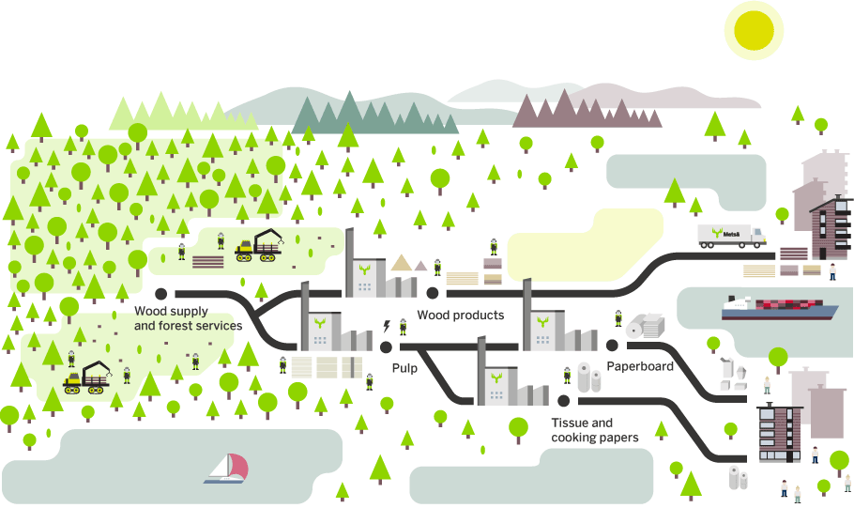
Forest Management Standards
Chain-of-Custody/Supply Chain Standards
Protection of Biodiversity
Public Participation
Protection of Soil and Water
Ensure Forest Regeneration
Indigenous Peoples Rights
Qualified Logging Professionals
Worker Safety and Rights
Notes:
To be certified, an enterprise most conform to the system standards. Separate sets of standards cover forest management and the post-harvest supply chain. Forest Management Standard cover topics like protection of soil and water, indigenous peoples rights, public involvement, timely regeneration, and protection of biodiversity. Forest Management Certification allows solid wood and wood fiber from Michigan State Forests to enter the certified supply chain and end up as FSC or SFI certified products.

Slide 25
Certification Standard Requirements
Forest Stewardship Council (FSC) | Sustainable Forestry Initiative (SFI)
Requires protection of forest ecosystems and functions, including genetic, species, and ecosystem diversity. | Requires a "program to promote the conservation of native biological diversity."
Requires protection of Rare, Threatened or Endangered (RTE) species, based on credible scientific analysis, assessments of potential impacts to RTE species prior to any harvest, and safeguards to protect and/or enhance RTE species. | Requires "a program to protect federal- or state-listed threatened or endangered species." Additionally requires a program to locate “viable occurrences” of globally imperiled species, which would generally trigger legal protection.
Notes:
Both certification standards require protection of native biodiversity and Rare, Threatened, and Endangered Species.

Slide 26
Notes:
Pause for Questions

Slide 27
Additional Topics
Summary of Seasonal Restrictions

Slide 28
Insect/Disease Restrictions
Oak Wilt: April 15 to July 15.
Pine bark beetle: March 1 through July 1

Slide 29
Wildlife Restrictions
Kirtland’s Warbler Nesting: May 1st to August 15th. At least 500 feet.
Red Shouldered Hawk Nest Tree: March 15 to July 15 (NLP). April 1 to July 30 (UP). February 15 to July 1 (SLP). 5 Chain (330 feet) buffer
Eagle Nest: Only harvest September 1 through December 31.
Loon: April 15th - August 15th. Next to Lake.

Slide 30
Recreation Restrictions
Hunting: Bear-September 29 thru October 2nd or Deer-November 13 thru November 16th.
Snowmobile Trail: December 1 to March 31

Slide 31
Other Restrictions
National Guard: May 1 to October 31
Bark Slippage: April 15 to July 15

Slide 32
Questions?

