Slide 1
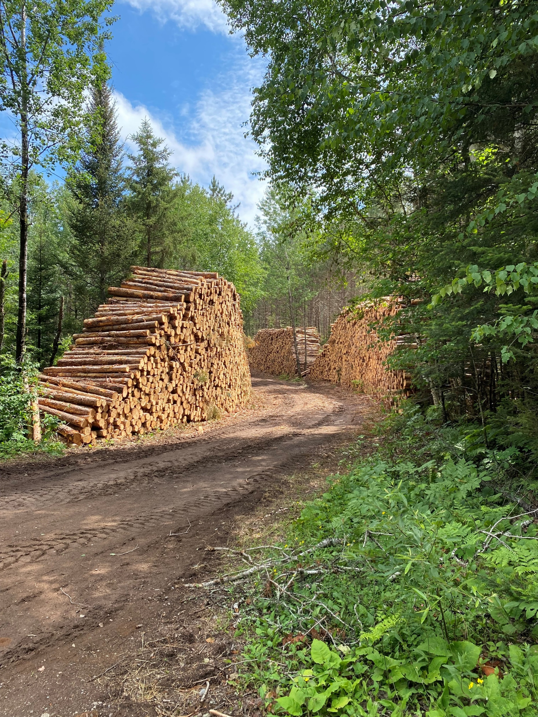
Upper Great Lakes Loggers Survey
Bob Smail
Forest Ecology and Economics
Forestry Division
Sustainable Forestry Conference
April 19, 2023 - Florence, WI

Slide 2
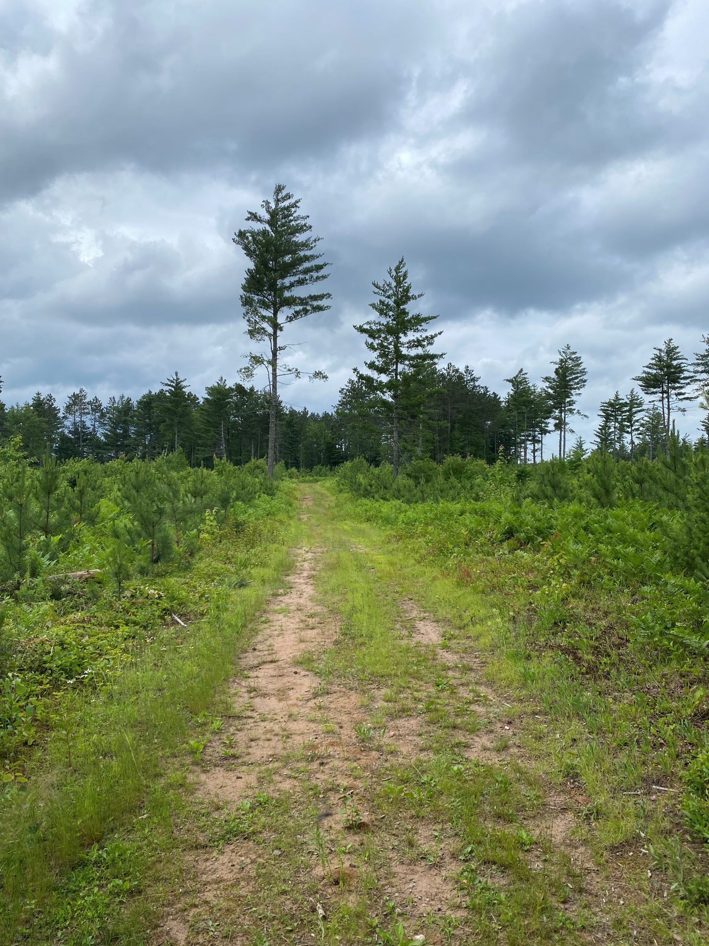
Methods
Demographics
Harvest Practices
Challenges

Slide 3
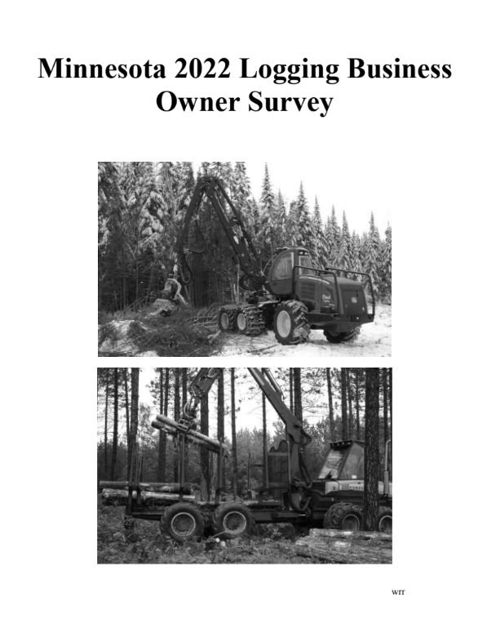
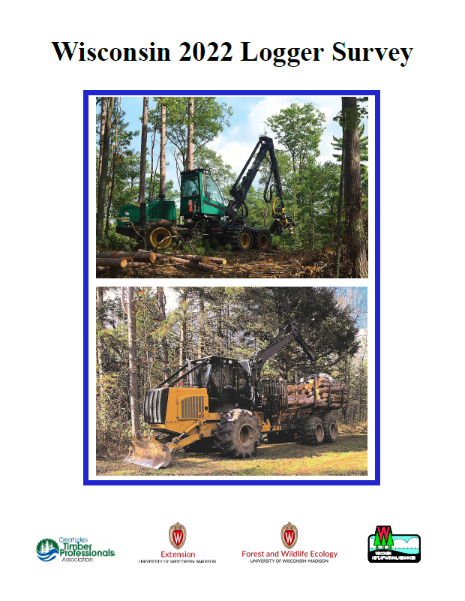
Methods
States coordinated design to include a large percentage of identical questions.
1100 surveys sent out to loggers and haulers in Minnesota and Wisconsin.
Wisconsin
Assisted by GLTPA
800 surveys sent out through UW Survey Center
43.7% response rate
Minnesota
300 surveys mailed by University of Minnesota
50% response rate
Michigan
Problems during administration of survey led to unusable response rate

Slide 4
Methods
Demographics
Harvest Practices
Challenges

Slide 5
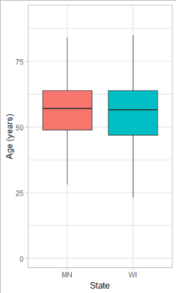
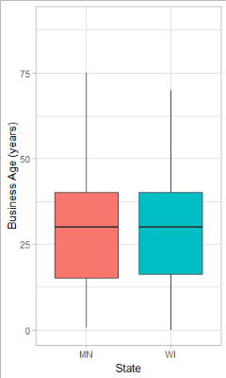
Demographics
Primary owner age was very similar
WI = 55 years
MN = 56 years
Second owner age was younger in MN
WI = 52 years
MN = 46 years
Mean years in business was very similar
WI = 34 years
MN = 35 years
Similar business ages
WI = 29 years
MN = 31 years

Slide 6
Methods
Demographics
Harvest Practices
Challenges

Slide 7
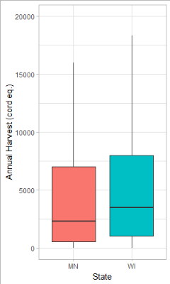
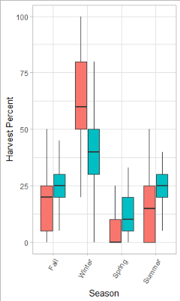
Harvest Practices
WI companies had a larger annual harvest
WI 4050 Cord-equivalents
MN 3000 Cord-equivalents.
MN Harvests significantly more in the winter compared to WI.
More wood cut on private ownership.
State | PF | CF | SF | NF
WI | 58% | 15% | 5% | 3%
MN | 39% | 25% | 28% | 4%

Slide 8
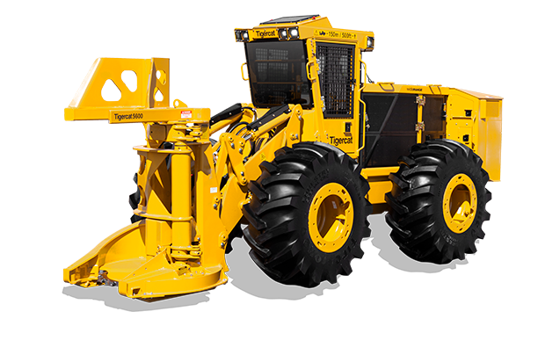
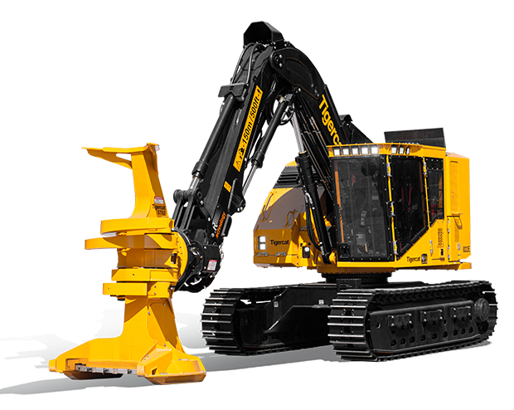
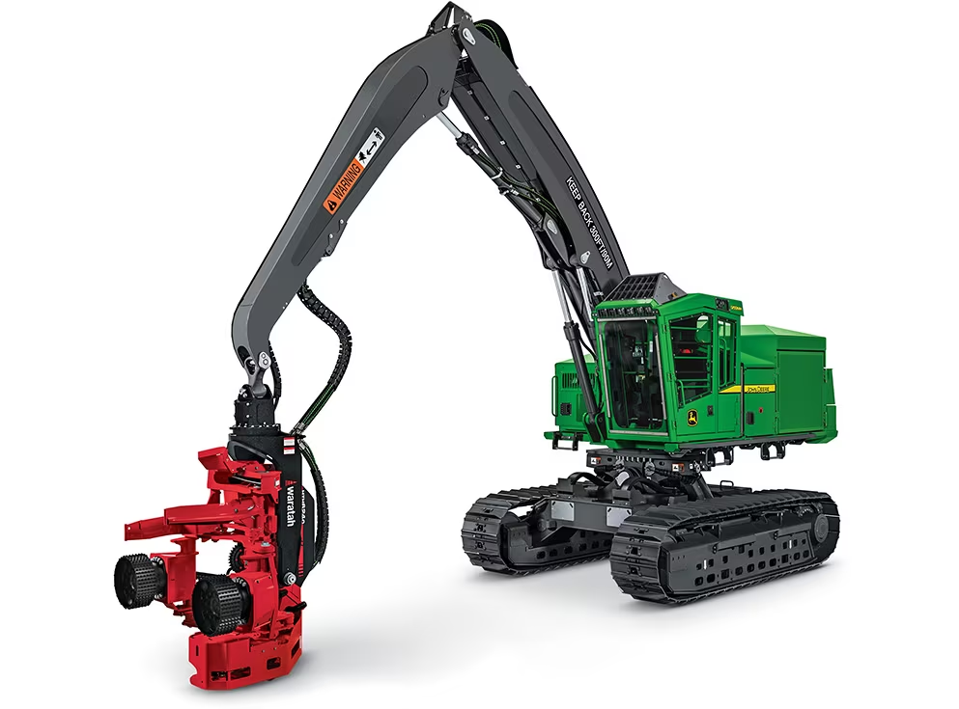
Harvest Practices
MN companies prefer grapple skidders (71% of volume) while WI prefers forwarders (89%).
WI contracts more hauling (82%) than MN (54%).
More volume harvested with CTL harvesters in WI.
State | Chainsaw | CTL | DtT FB | RtT FB
WI | 17% | 60% | 6% | 17%
MN | 2% | 28% | 31% | 39%

Slide 9
Methods
Demographics
Harvest Practices
Challenges

Slide 10
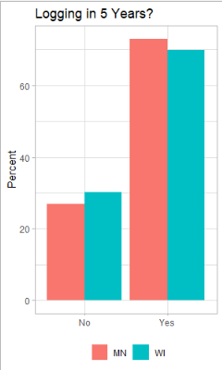
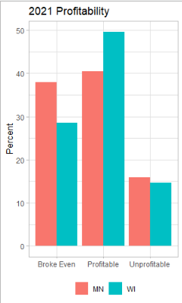
Challenges
Majority in both states expect to be logging in 5 years.
Majority were profitable or broke even in 2021. Moreso in WI.
Access to loans was not a challenge.
COVID had a bigger impact on profitability in Wisconsin.
A majority of companies in WI (52%) and MN (53%) applied for Paycheck Protection Program.

Slide 11
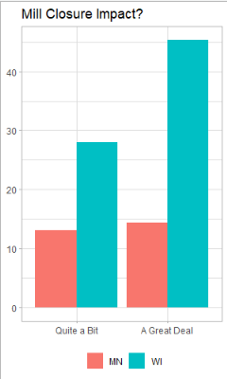
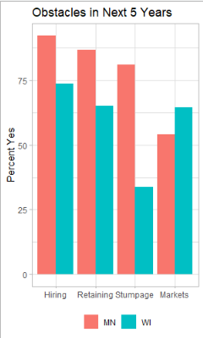
Challenges
Mill closures in Duluth, Park Falls, and Rapids had a large impact on Wisconsin companies.
Biggest obstacle in both states is hiring and retaining a quality workforce.
Stumpage is an obstacle in MN but not in WI.
Markets are a bigger obstacle in WI.
Significant uncertainty regarding carbon, but most think forestry can reduce CO₂
Significant skepticism regarding carbon market impact on the industry.

Slide 12
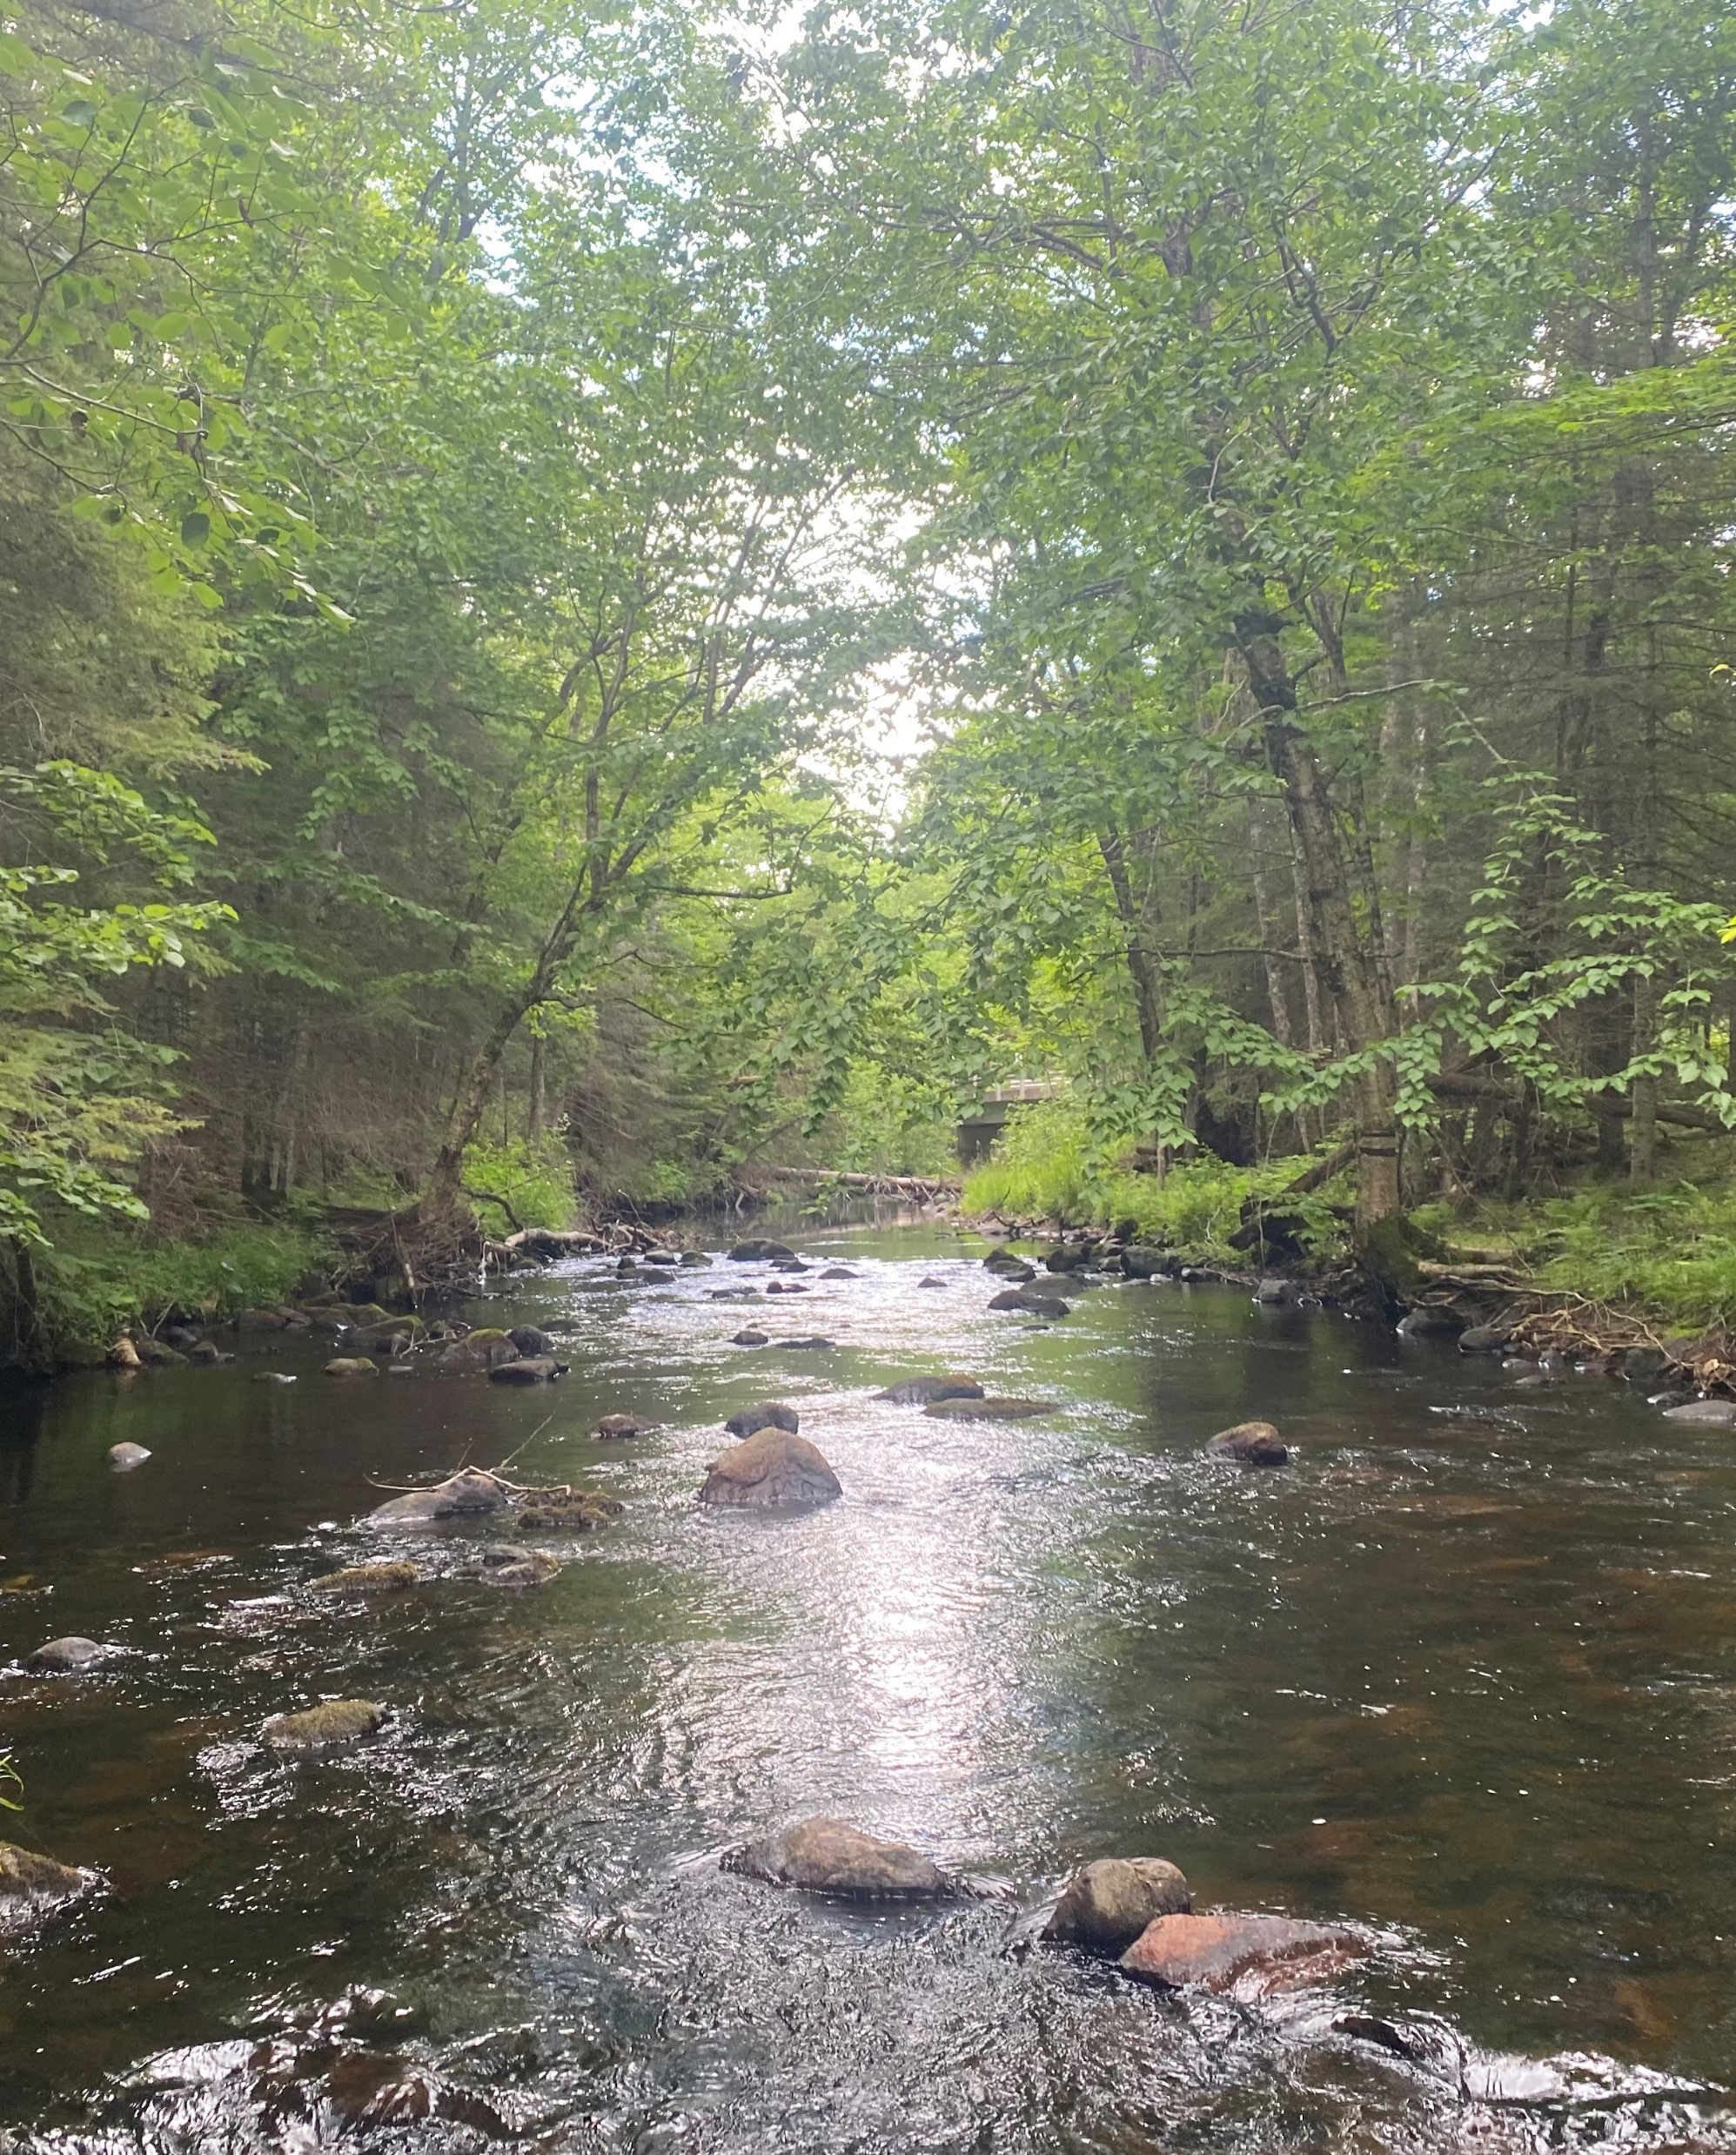
Conclusions
Demographics are very similar between WI and MN with little change since 2017
Ownership not necessarily aging.
WI loggers harvest more annually and across more seasons than MN companies.
WI Harvests more on private land.
Significant differences in equipment preferences.
Most companies broke even or were profitable in 2021 although mill closures had bigger impact in WI.
Hiring and retaining quality workforces is biggest obstacle to growth in both states..

Slide 13
Questions?
robert.smail@wisconsin.gov

