Slide 1
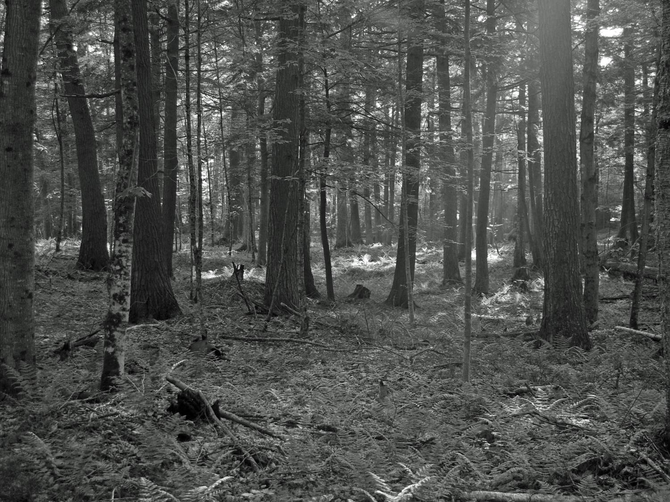
Wisconsin’s
Threatened and Endangered Species Laws and
Forest T/E Species
Carly Lapin, Wisconsin DNR
Bureau of Natural Heritage Conservation

Slide 2
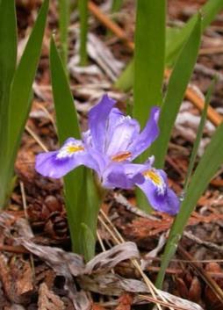
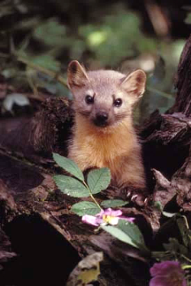
Bureau of Natural Heritage Conservation
Vision:
We envision a Wisconsin with a thriving natural heritage supported by, and benefiting, everyone.
Mission:
We work to conserve Wisconsin’s native plants, animals, and their habitats using science, collaborative approaches, and creative strategies.
L. Hays
D. Feldkirchner
E. and P. Bauer
Notes:
Created in 1982
Formerly Bureau of Endangered Resources
Responsible for conserving Wisconsin’s non-game animals, rare plants, and their habitats, including state and federally protected species.
NHC also manages the country’s oldest and largest system of State Natural Areas designed to protect outstanding examples of Wisconsin’s biodiversity.

Slide 3
Threatened and Endangered
Endangered: Any species whose continued existence as a viable component of this state’s wild animals or wild plants is determined by the Department to be in jeopardy on the basis of scientific evidence.
Threatened: Any species which appears likely, within the foreseeable future, on the basis of scientific evidence, to become endangered.
“Endangered” and “Threatened” = “Listed”

Slide 4
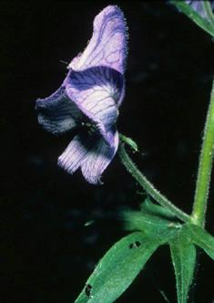
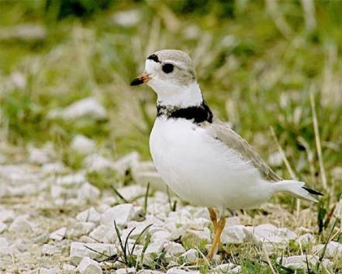
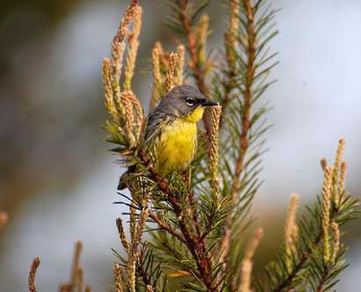
Federal Threatened & Endangered
Animals protected everywhere in the country
Plants protected on federal lands or if taken in violation of state law or criminal trespass law
J. Bartholmai
K. Kohout
D. Feldkirchner
D. Malueg
Notes:
Listed by the USFWS
Threatened or Endangered throughout the United States

Slide 5
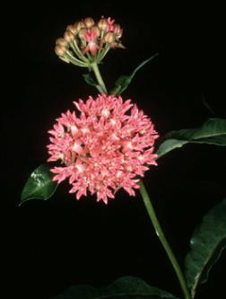
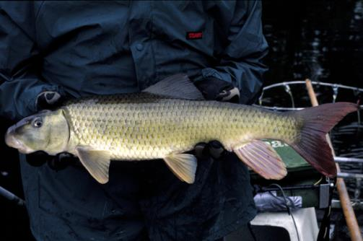
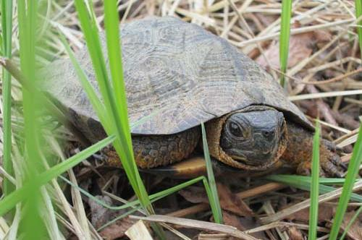
State Threatened & Endangered
Animals protected everywhere in the state
Plants protected on public lands only, exemption on public lands for agriculture, forestry, and utility activities
Conservation is required
T. Meyer
J. Lyons
A. Badje
Notes:
WDNR is required by law to implement conservation programs on state-listed species
Involves conducting research and developing programs directed at conserving, protecting, managing for, and restoring and propagating selected T/E species to the maximum extent possible.

Slide 6
Special Concern Species
Suspected problem of abundance or distribution in WI, but not yet proven
Avoid future endangerment
SC/M = fully protected by Migratory Bird Act
SC/P = protected wild animal
SC/H = take regulated by open/closed seasons
SC/N = no laws regulating use, possession, or harvesting
SC/FL = federally listed, not listed in WI
Notes:
- Some of these are legally protected, others not

Slide 7
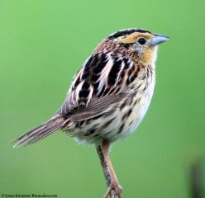
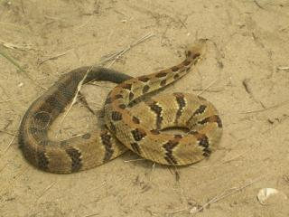
Other Protective Laws
Federal Lacey Act
Federal Migratory Bird Treaty Act
Federal Bald and Golden Eagle Protection Act
Protected Wild Animals Rule (s. 10.02, Wis. Adm. Code)
K. Laubenstein
L. Erikson
R. Paloski
Notes:
Lacey Act: federal violation to import, export, sell, receive, acquire, purchase, or conduct interstate transport of any fish, wildlife, or plant taken or possessed in violation of federal, tribal, state, or foreign law. It is illegal to transport federal or state listed T/E species obtained in Wisconsin out of the state without a valid permit.
MBTA: most birds and their parts are protected from being killed, taken, transported, possessed, bought, sold, imported, or exported without a federal permit. Does not apply to resident game birds or non-native species.
BGEPA: Protects bald and golden eagles, as well as their nests, and parts

Slide 8
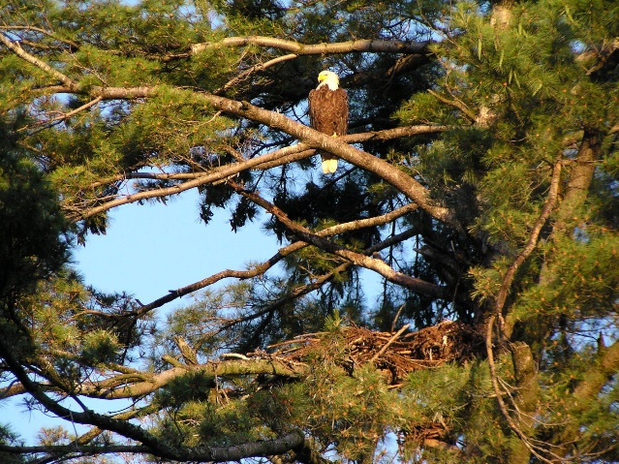
Protection from what?
Protection from ‘take’, transport, possession, processing, or selling
Take is the direct mortality of an animal or plant
- Defined by the State as shooting, pursuing, hunting, catching, or killing any wild animal or cutting, rooting up, severing, injuring, destroying, removing, or carrying away any wild plant.
Habitat is not protected by state law
R. Eckstein
Notes:
WDNR can issue T/E species permit to allow an individual to conduct certain activities under specified conditions (eg, for research)
WDNR can also issue ‘Incidental Take Permits’
Habitat can be protected by federal law

Slide 9
Why are Species Rare/T/E in Wisconsin?

Slide 10
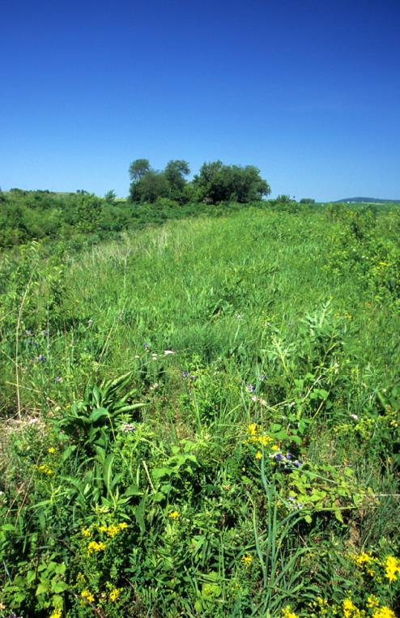
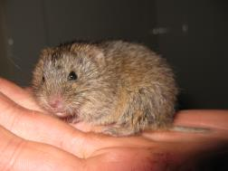
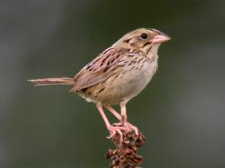
Why are species rare in WI?
Habitat loss

Slide 11
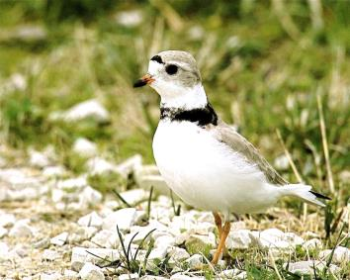
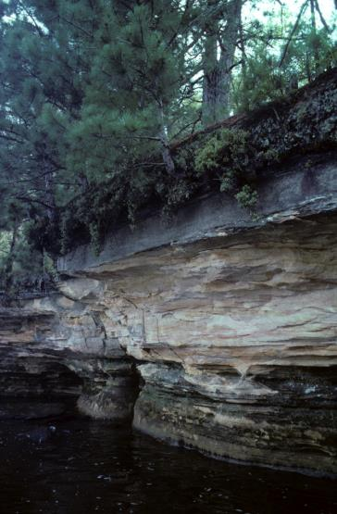
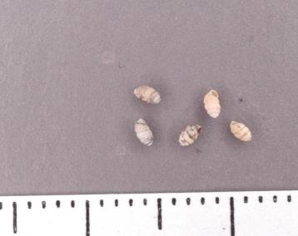
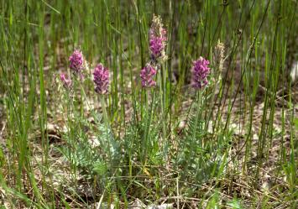
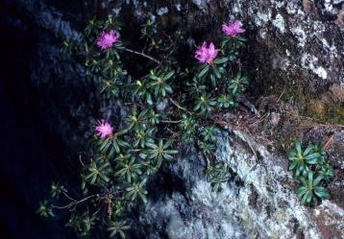
Why are species rare in WI?
Habitat loss
Habitat specificity

Slide 12
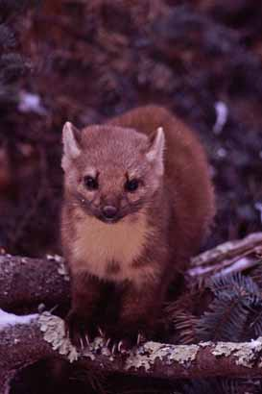
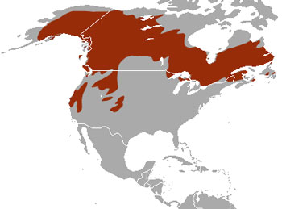
Why are species rare in WI?
Habitat loss
Habitat specificity
Edge of Range
A.B. Sheldon

Slide 13
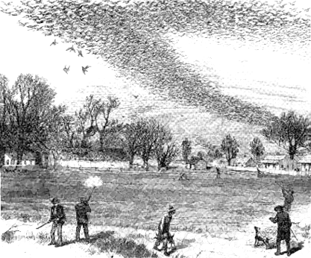
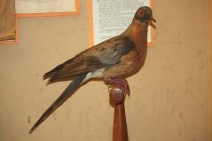
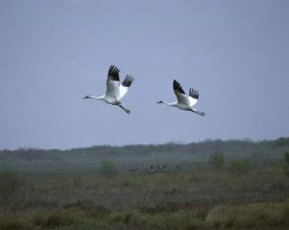
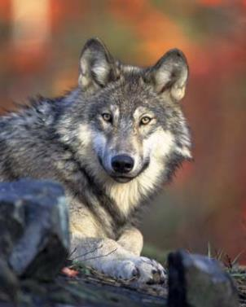
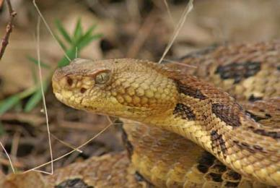
Why are species rare in WI?
Habitat loss
Habitat specificity
Edge of Range
Persecution/Overexploitation

Slide 14
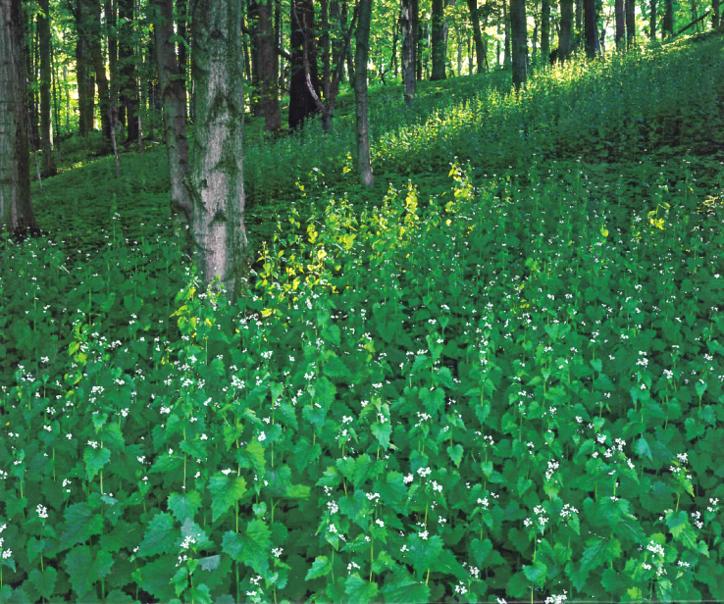
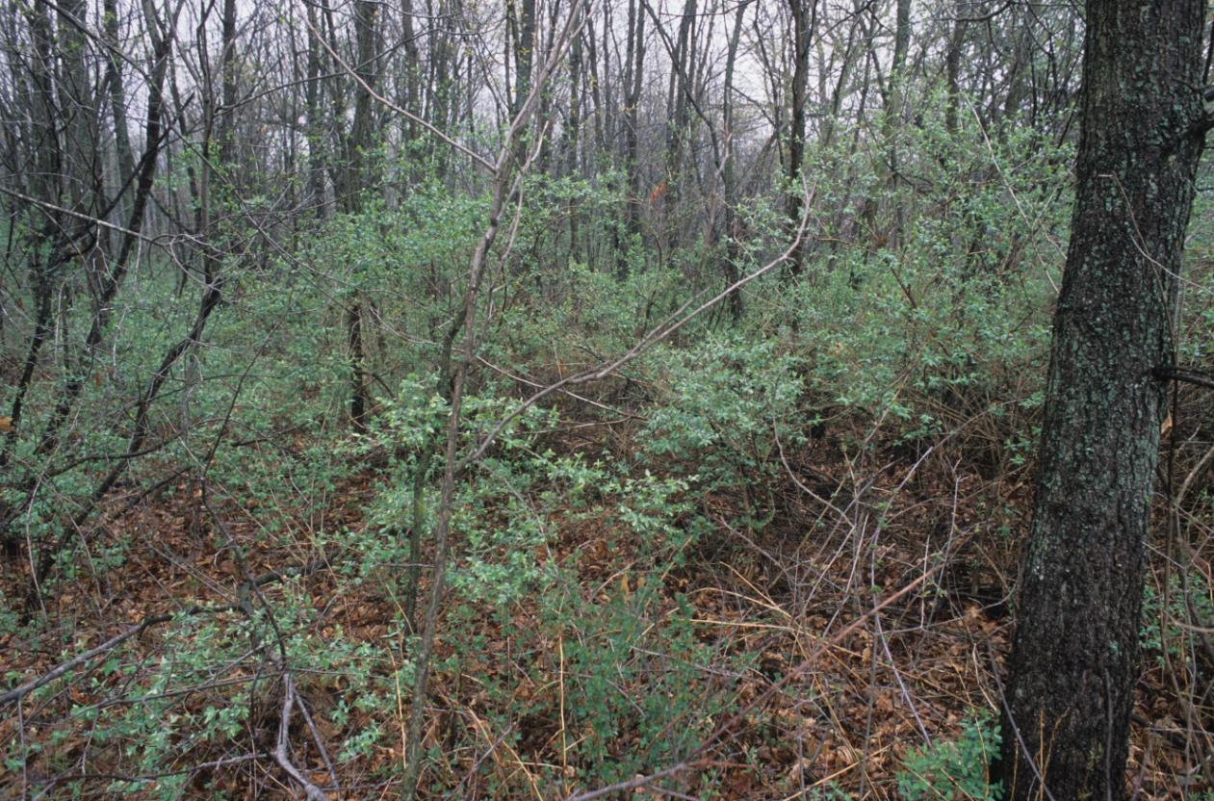
Why are species rare in WI?
Habitat loss
Habitat specificity
Edge of Range
Persecution/Overexploitation
Competition with other species (native and exotic)
Predation
Disease
Environmental Stressors
Notes:
A recent convention on biodiversity reported that invasive species are the 2nd greatest cause of species extinction
The world is currently in a biodiversity crisis with species declines and extinctions occurring at alarming rates.

Slide 15
Listed species in Northern Wisconsin forests
Forest Raptors
Forest Songbirds
Bird Rookeries
Turtles
Cave Bats
Notes:
- These are the species most often impacting forest management in northern WI

Slide 16
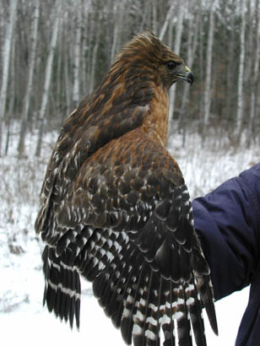
Forest Raptors
Notes:
- Bald eagles are protected and regulated by federal law. No state laws related to bald eagles or their nests.

Slide 17
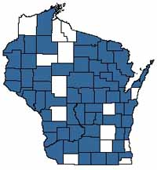
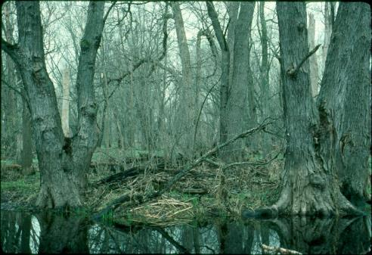
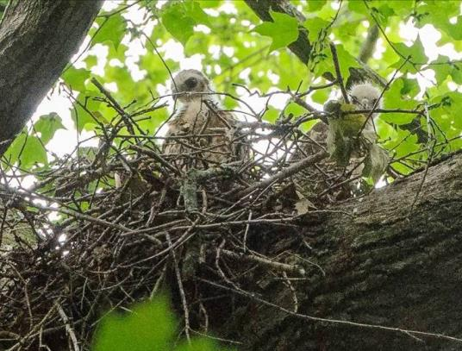
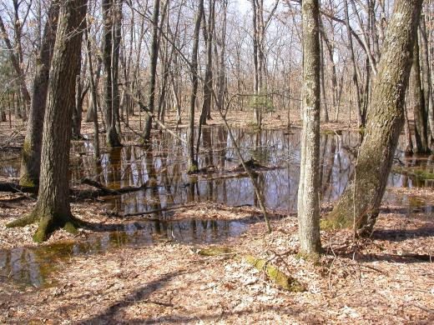
Red-Shouldered Hawk (THR)
Notes:
Large stands of older-aged to mature bottomland hardwoods
Riparian areas, deciduous swamps, and northern hardwood or mixed upland forests with wetland pockets or ephemeral ponds

Slide 18
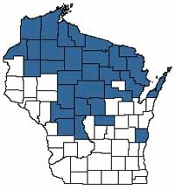
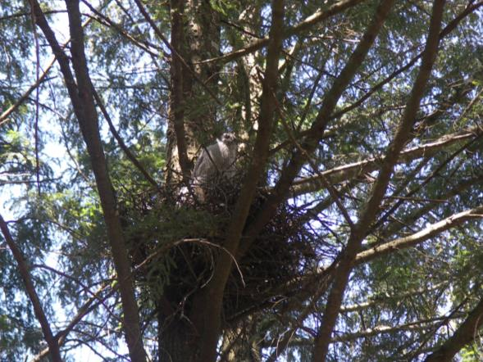
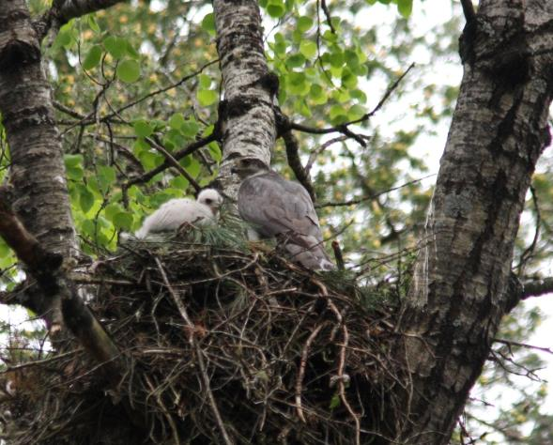
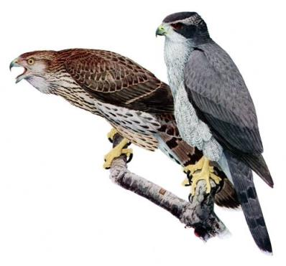
Northern Goshawk (SC)
Notes:
Mature deciduous, coniferous, or mixed forest types in northern 2/3 of Wisconsin
Closed canopy forest with wide-diameter trees for nesting
nest placed below the canopy in upper portion of tree (yellow birch, hemlock, pine)
Common for a territory to have multiple alternative nests
Territorial adults are very aggressive to humans entering within ½-mile or more of active nest during the breeding season (Feb 1 – July 31)

Slide 19
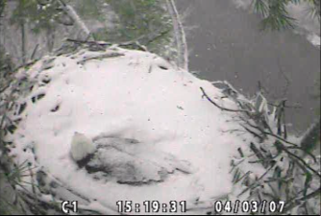
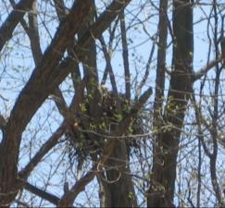
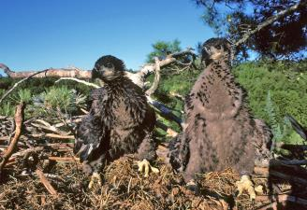
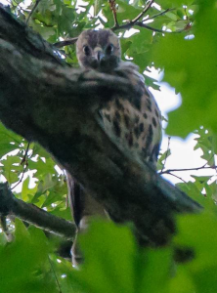
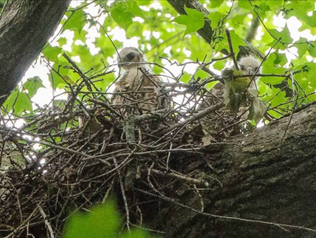
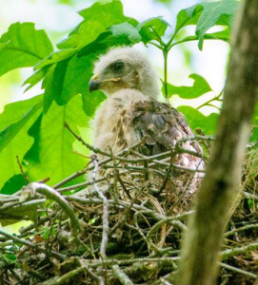
Forest Raptor Avoidance
Seasonal restrictions (i.e., avoid harvest/disturbance during the breeding season)
Often based around a nest location, if known
Notes:
Disturbance during breeding season can lead to nest abandonment. If there are eggs/chicks in the nest, that counts as take
It is beneficial to know the nest location because you can target the avoidance measures

Slide 20
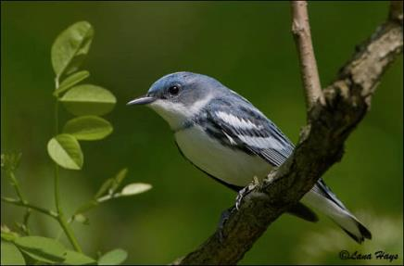
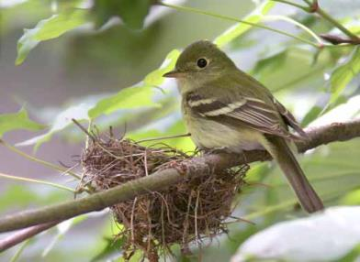
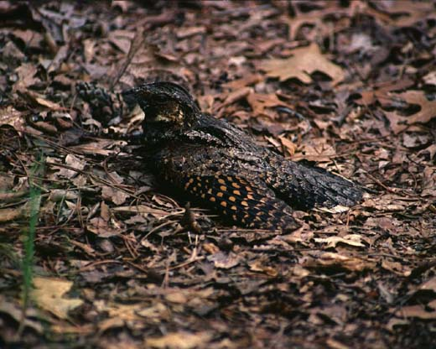
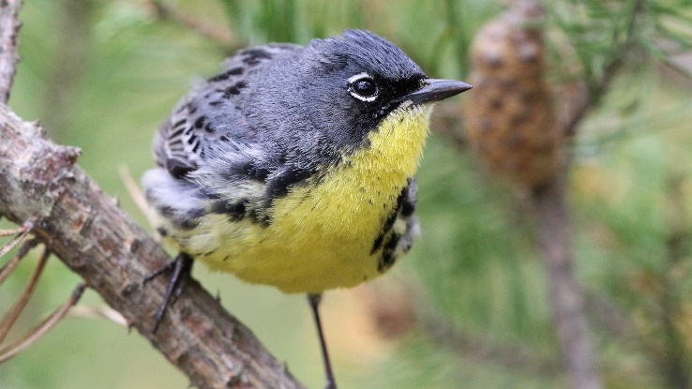
Listed Forest Songbirds
Nests very difficult to locate
Seasonal restrictions based on habitat/forest type
M. Woodford

Slide 21
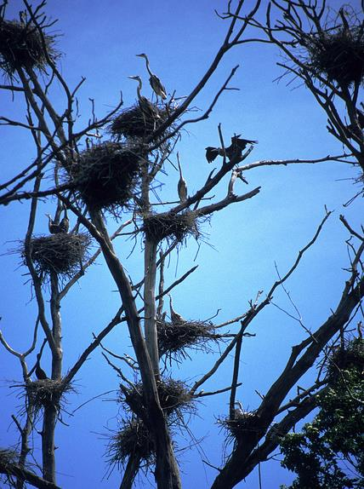
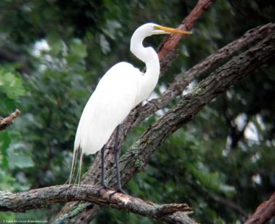
Bird Rookeries
Notes:
Area where more than one pair of birds nest in a group
One or multiple species of birds
Important because large number of breeding individuals are found in a single place
Seasonal avoidance dates, plus recommend leaving a forested buffer around the rookery so it stays put

Slide 22
Listed Turtles

Slide 23
Blanding’s Turtle (SC/P)
Notes:
- Aquatic habitat includes marshes, shallow bays of lakes, impoundments, slow streams, oxbows and backwaters of rivers, and sedge meadows and wet meadows near these features
Semi-terrestrial, move between a variety of habitat types during active season (March – October)
Overwinter underwater
Nest in sandy soils up to 900 feet from wetland or waterbody
Reach sexual maturity at 17-20 years of age

Slide 24
Wood Turtle (THR)
Notes:
Considered for Federal Listing – decision coming early 2024
Found in rivers and streams with adjacent wetlands and upland deciduous and mixed forest
Mainly terrestrial during the summer months, generally staying within 900 feet of rivers and streams
Nests in sand or gravel, usually within 200 feet of the water

Slide 25
Turtle Avoidance
Avoid suitable nesting habitat near streams and wetlands during the nest incubation period (May-Sep/Oct)
Notes:
- Some additional seasonal avoidance may be recommended near known populations for added protection

Slide 26
Cave Bats
Federal Review
Big brown
Little brown
Proposed Fed. Endangered
Federally Endangered
Northern long-eared
Tricolored
Notes:
All 4 of these species are state-listed threatened in Wisconsin.
NLEB was recently changed from Federally Threatened to Endangered (March 2023)
Tricolored bat (formerly eastern pipistrelle) is proposed Federally Endangered, final rule expected 2023
Little brown bat is under review for federal listing, decision expected 2023

Slide 27
Important Bat Facts
Cave bat decline due to white-nose syndrome
Wisconsin, Michigan, and Minnesota DNR’s have developed a joint Habitat Conservation Plan
Regulatory ‘coverage’ is provided for
forest management,
prescribed burning, and
road and trail construction and maintenance for forest management and recreation
Alan Hicks
Notes:
- Decline in bat populations from WNS is considered the most precipitous decline in North American wildlife in recorded history.

Slide 28
Bat Avoidance Measures
Implement sustainable forestry (Chapter 24 of Silviculture Guidelines)
No timber harvest (year round)
Within 150 feet of known occupied maternity roost tree
Within ¼ mile of known hibernaculum entrance
No loud noises within ¼ mile of known hibernaculum entrance
Timber harvest activities tracked and reported
Notes:
These avoidance measures (and the HCP) cover forest management on state lands
Non-DNR and non-federal landowners can also be covered by the HCP if they meet certain eligibility requirements and obtain a certificate of inclusion
LEP Eligibility Checklist
All County Forests are eligible for coverage in the Landowner Enrollment Program regardless of whether they meet the size or habitat feature criteria.
Landowners conducting forest management and own more than 10,000 acres of forestlands in Wisconsin (contiguous or noncontiguous)
Landowners conducting forest management activities on lands which contain or overlap with at least one bat habitat feature:
Lands of any size that include known hibernacula entrances or are within the 0.25-mile buffer of a known entrance.
Lands of any size that contain a known occupied maternity roost tree or overlap with the 150-foot roost tree buffer.
How to Apply – If a landowner meets the criteria for enrollment above, they may apply for coverage under the ITP. The first step in applying for the LEP is confirming eligibility by consulting the county-township habitat features screening map. If the property falls within one of the townships with habitat features, the landowner should send a map or GIS data file with the entire property boundary to the Bat HCP coordinator. The mapping information must include all property boundaries, township-range information and enough detail so the location can be determined.

Slide 29
Questions?

